Slide 1
Immunological Distinction between wP & aP based Vaccine

Slide 2
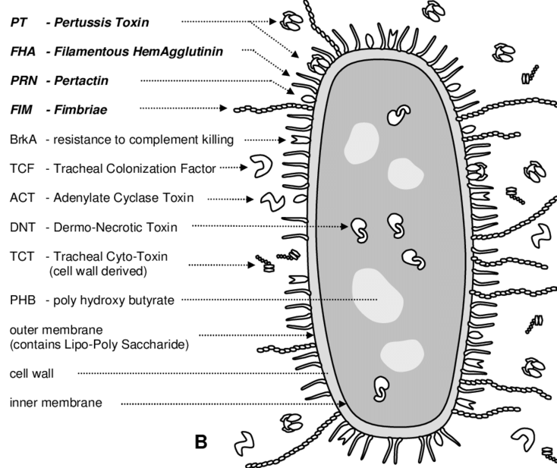
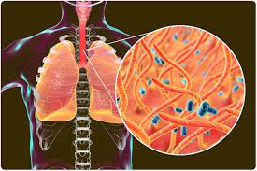
Brodetella pertussis

Slide 3
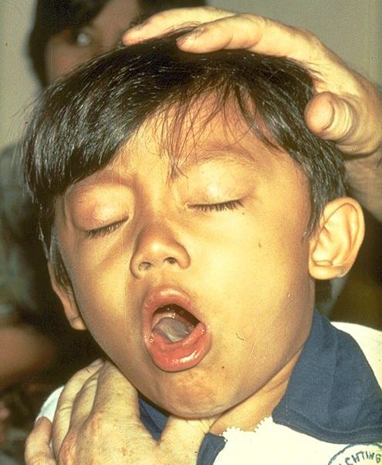
Bordetella pertussis, the germ
Gram-negative rod
Humans are the only host
Incubation period 6-to-21 days (usually 7-to-10 days)
Duration of illness 6-to-10 weeks (usually 6 weeks)
Expected occurrence 3-to-5 year cycles of increased disease
Pertussis is under reported, 40-160 fold less than actual illness
Asymptomatic infections are 4–22 times more common than symptomatic infections
Notes:
Adults are often Asymptomatic, but infants are not

Slide 4
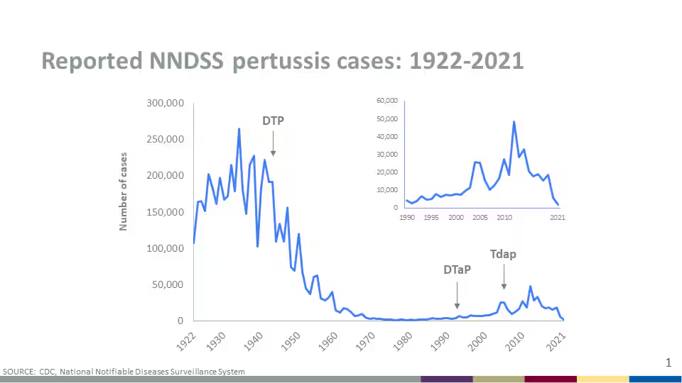
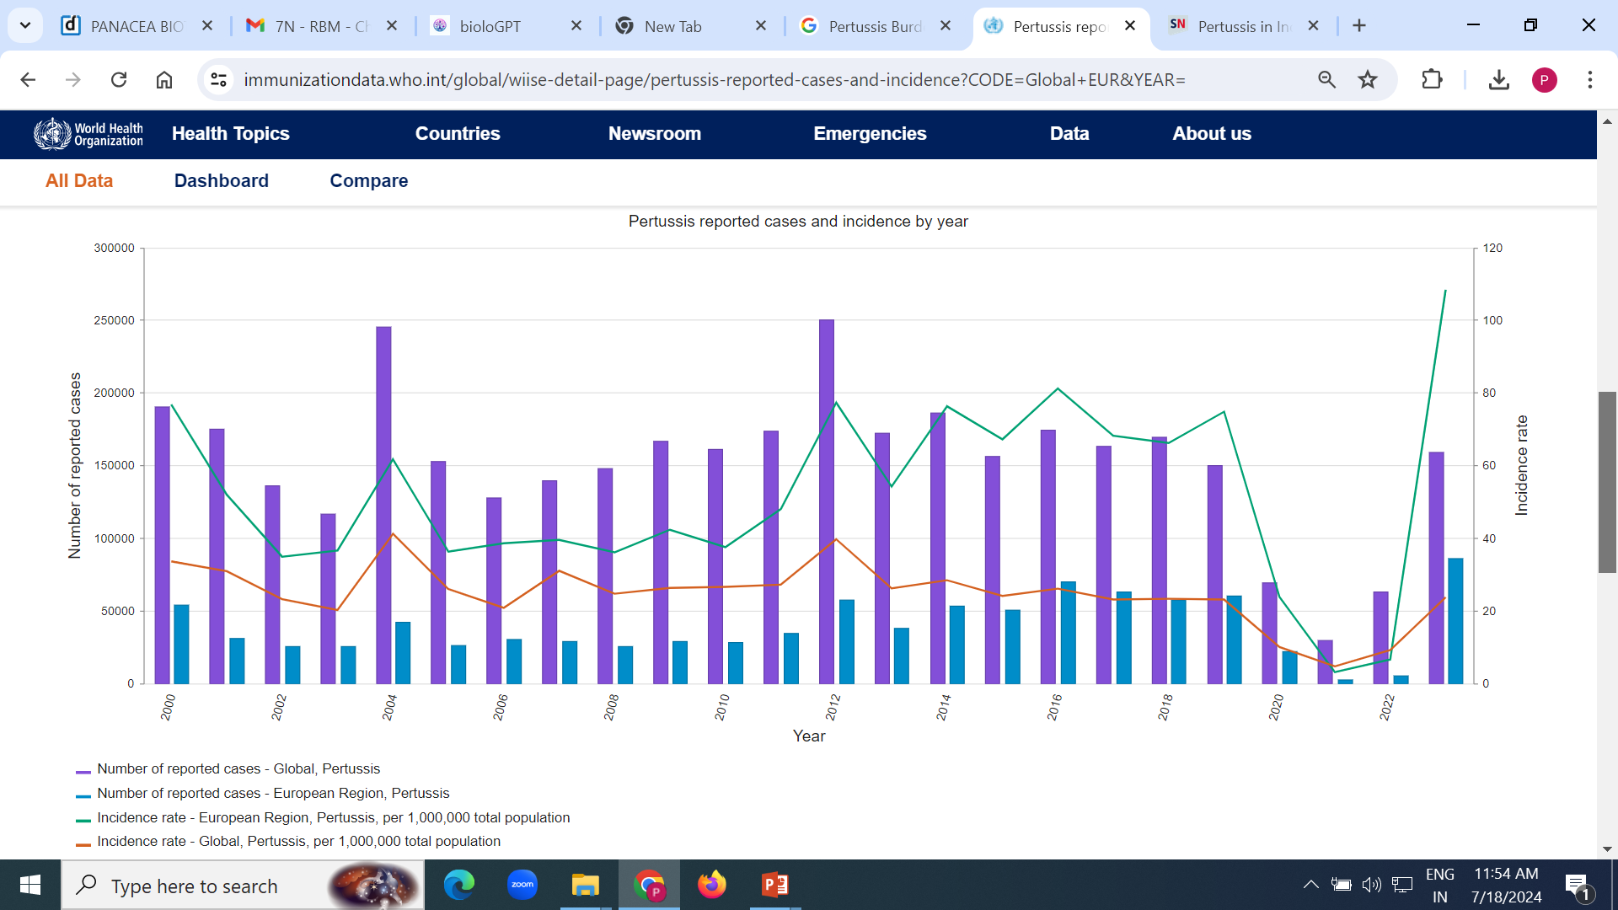
Pertussis Burden: Global
Source: WHO Immunization Data portal
World Health Organization, WHO, 2024,

Slide 5
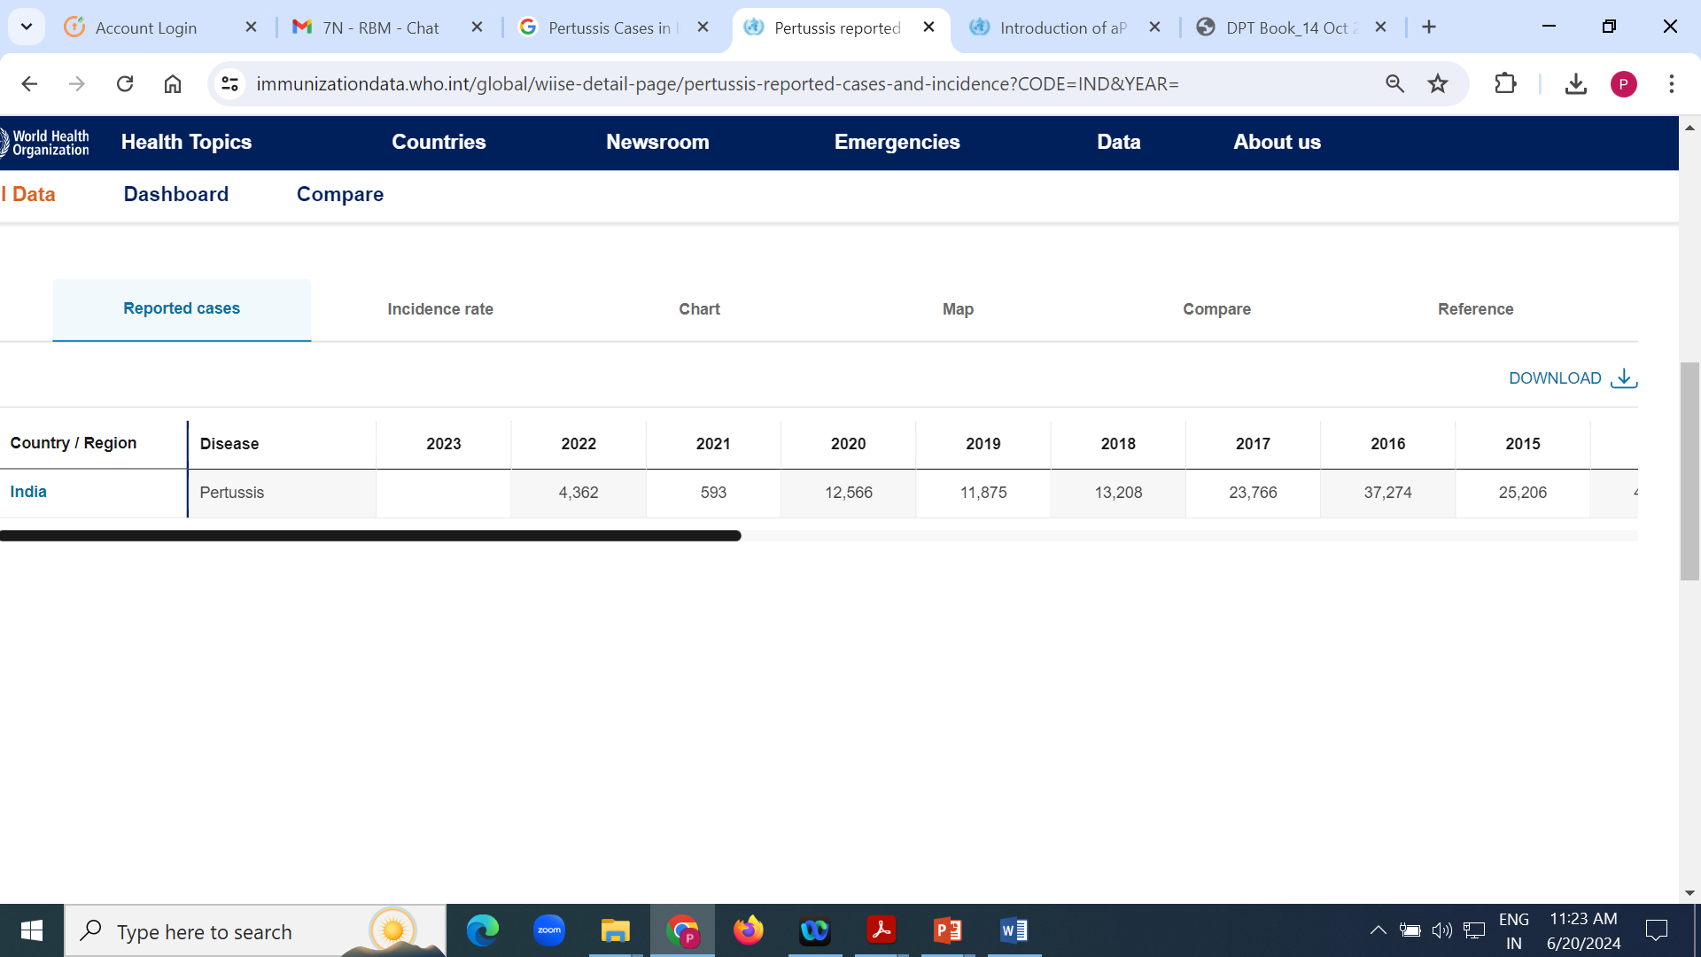
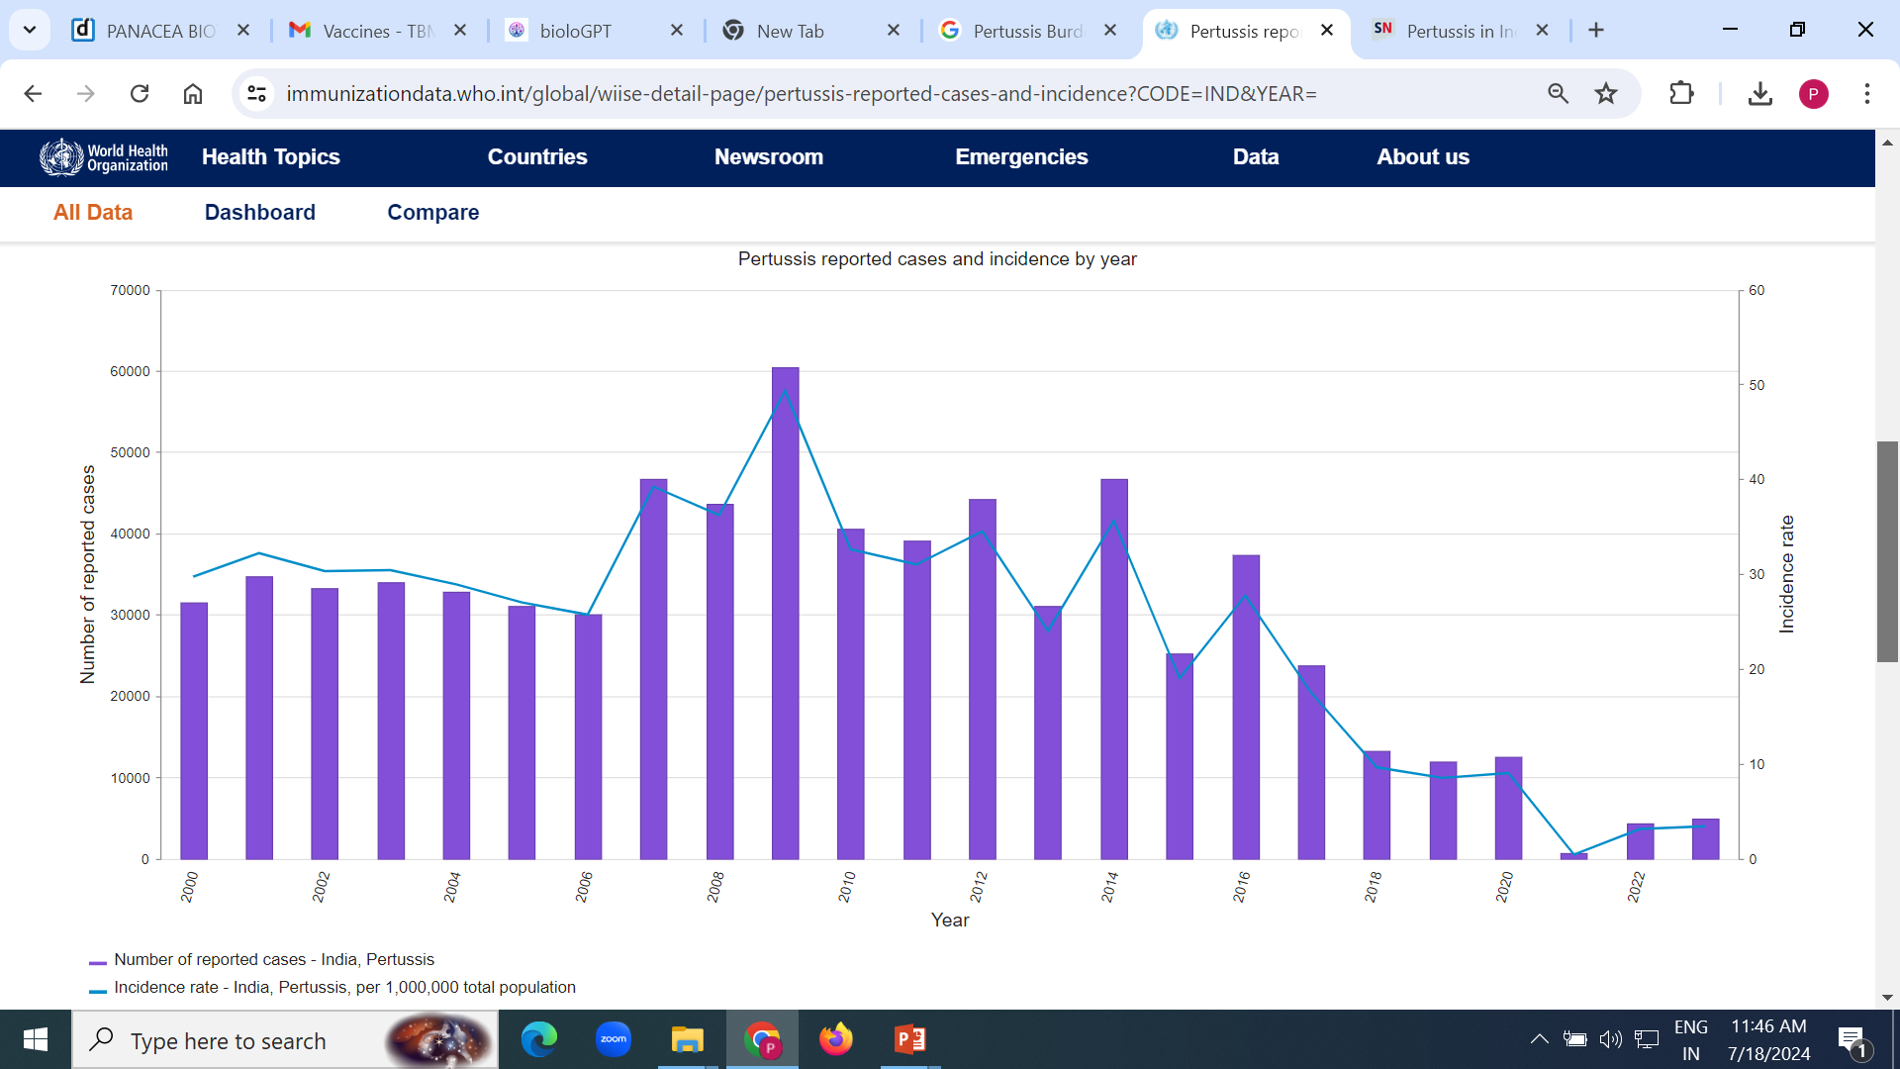
Pertussis Burden in India
Source: WHO Immunization Data portal
World Health Organization, WHO, 2024, All rights reserved
Notes:
The table in slide represents the pertussis burden in India.
Reference
WHO vaccine-preventable diseases: monitoring system. 2020 global summary. Available at:
https://apps.who.int/immunization_monitoring/globalsummary/countries?countrycriteria%5Bcountry%5D%5B%5D=IND&commit=OK Accessed on: 12 November 2020.

Slide 6
Pertussis Resurgence: Global Scenario
UK (2012)
Australia (2011)
10 Death
>100 times
Increased case 1991 to 2011 in Australia¹
Infants <12 months old in 2012, highest rate of mortality from pertussis since 1982⁴
California (2010)
Washington (2012)
>9000 cases
37.5/100 000
In 60 years, highest pertussis-affected number in 2010²
The rate of disease exceeded the California epidemic in 2012³
Ausielloa C, et al. mBio. 2014;5(3):e01339–14.
Winter K, et al. J Pediatr. 2012;161:1091–1096.
Clark T. J Infect Dis. 2014;209:978–981.
Chiappini E, et al. BMC Infect Dis. 2013;13:151.
UK: United Kingdom.
Notes:
In Australia, reported new cases increased more than 100 times from 1991 to 2011.¹
In Californian epidemic of 2010, over 9,000 cases highest number in 60 years.²
In 2012 epidemic in Washington, rate of disease exceeded that in the California epidemic.³
In United Kingdom, 10 deaths in infants under 12 months old in 2012, highest rate of mortality from pertussis since 1982.⁴
References
Ausielloa CM, Cassone A. Acellular pertussis vaccines and pertussis resurgence: Revise or replace? mBio. 2014;5(3):e01339–14.
Winter K, Harrimann K, Zipprich J, et al. California pertussis epidemic, 2010. J Pediatr. 2012;161:1091–1096.
Clark TA. Changing pertussis epidemiology: Everything old is new again. J Infect Dis. 2014;209:978–981.
Chiappini E, Stival A, Galli L, et al. Pertussis re-emergence in the post-vaccination era. BMC Infect Dis. 2013;13:151.

Slide 7
Shift From wP to aP Vaccine and Consequences
Reactogenic wP
High reactogenic activity of wP resulted in remarkable drop in vaccination coverage in most high-income countries.¹
>42,000 cases of pertussis reported in 2012, which was the highest number in more than 50 years.²
Introduction of aP
aP vaccination was introduced. Gradually the aP vaccine replaced wP vaccine since early 1990 and by 1996 whole US shifted to aP.¹
The re-emergence of pertussis indicated rapidly waning protection following aP vaccines, especially in those who were not “primed” with, DTP (whole cell).^{3,4}
Outbreak of pertussis
Following switch from wP to aP, several countries reported pertussis outbreaks.¹
da Silva Antunes R, et al. J Clin Invest. 2018;128(9):3853–3865.
Warfel J, et al. Proc Natl Acad Sci USA. 2014;111(2):787–792.
van der Lee S, et al. Front Immunol. 2018;9:51.
Chen Z, et al. Hum Vaccin Immunother. 2017;13(4):744–756.
wP: Whole-cell pertussis; aP: Acellular pertussis; DTP: Diptheria, tetanus toxoids and pertussis.
Notes:
As inactivated wP vaccine was more reactogenic there was dramatic drop in vaccination coverage in most high-income countries and there was a search of another pertussis vaccine that led to development of acellular pertussis (aP) vaccine. Gradually the aP vaccine has replaced wP vaccine since early 1990 and by 1996 whole US shifted to aP vaccine and resulted again in increase of pertussis vaccine coverage in newborns and infants. Pertussis outbreaks have been reported in various countries that have switched from wP to aP vaccine and many of the outbreaks have occurred in children who had received only acellular vaccine.¹
DTaP vaccination was started in 1996 in the United States and more than 42,000 cases of pertussis reported in 2012 was the highest number in more than 50 years.² Therefore, a new epidemiology of pertussis has emerged, with substantial evidence of rapidly waning protection following aP vaccines (both DTaP and Tdap) and especially in those who never received, that is, were not “primed” with DTP (whole cell).^{3,4}
References
da Silva Antunes R, Babor M, Carpenter C, et al. Th1/Th17 polarization persists following whole-cell pertussis vaccination despite repeated acellular boosters. J Clin Invest. 2018;128(9):3853–3865.
Warfel JM, Zimmerman AI, Merkel TJ. Acellular pertussis vaccines protect against disease but fail to prevent infection and transmission in a nonhuman primate model. Proc Natl Acad Sci USA. 2014;111(2):787–792.
van der Lee S, Hendrikx LH, Sanders EAM, et al. whole-cell or acellular pertussis primary immunizations in infancy determines adolescent cellular immune profiles. Front Immunol. 2018;9:51.
Chen Z, He Q. Immune persistence after pertussis vaccination. Hum Vaccin Immunother. 2017;13(4):744–756.

Slide 8
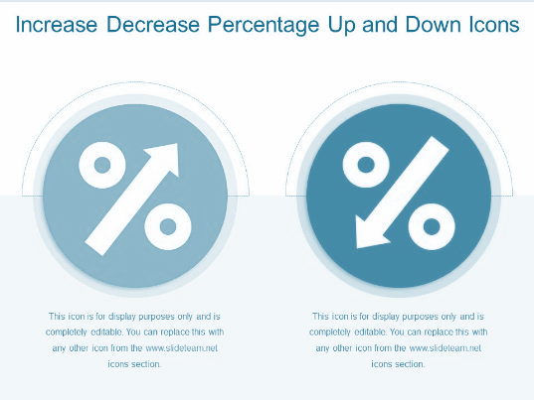


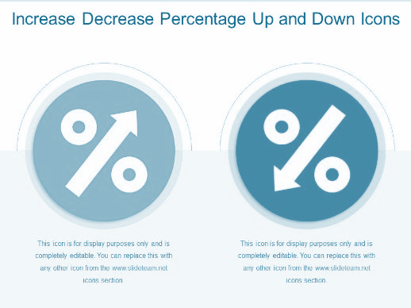


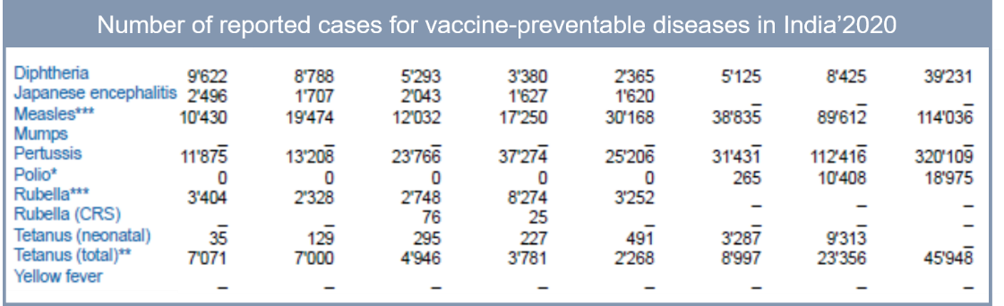
Paradox…
Resurgence Despite Vaccination: What’s Wrong?
Global trend: ASCENDING
Indian trend: DESCENDING
This RESURGENCE
is happening despite vaccination.
So, what is WRONG?????

Slide 9
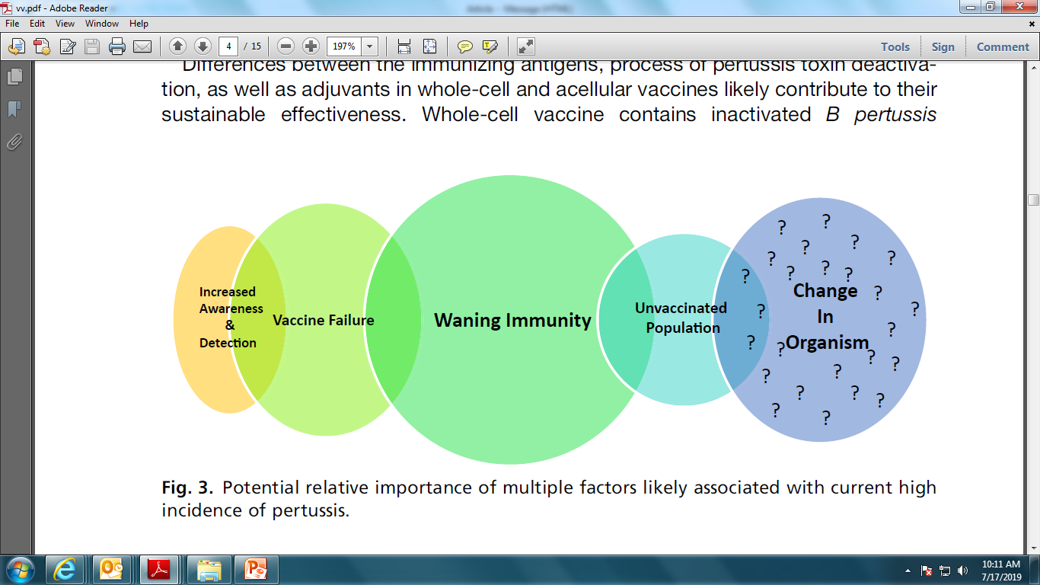
Possible Factors for Pertussis Resurgence
Shift in antigenic properties of circulating strains of B. pertussis
Vaccine and circulating strain mismatch
Declining vaccine uptake
Vaccine hesitancy and refusal
Previously underdiagnosed?
More awareness → increased case notification
Better diagnostic methods – PCR
Waning of vaccine- or infection-induced protection
Notes:
This slide sheds light on the possible factors for pertussis resurgence.

Slide 10
Reason for Pertussis Outbreak
Limited Antigenic Components in aP Vaccines
Mismatch between Antigen in Vaccine and Current Antigen Strain (Pathogen Adaptation)
Waning efficacy of acellular pertussis vaccine over time
Shorter duration of protection with aP vaccines
Immunological distinction between wP & aP vaccine

Slide 11
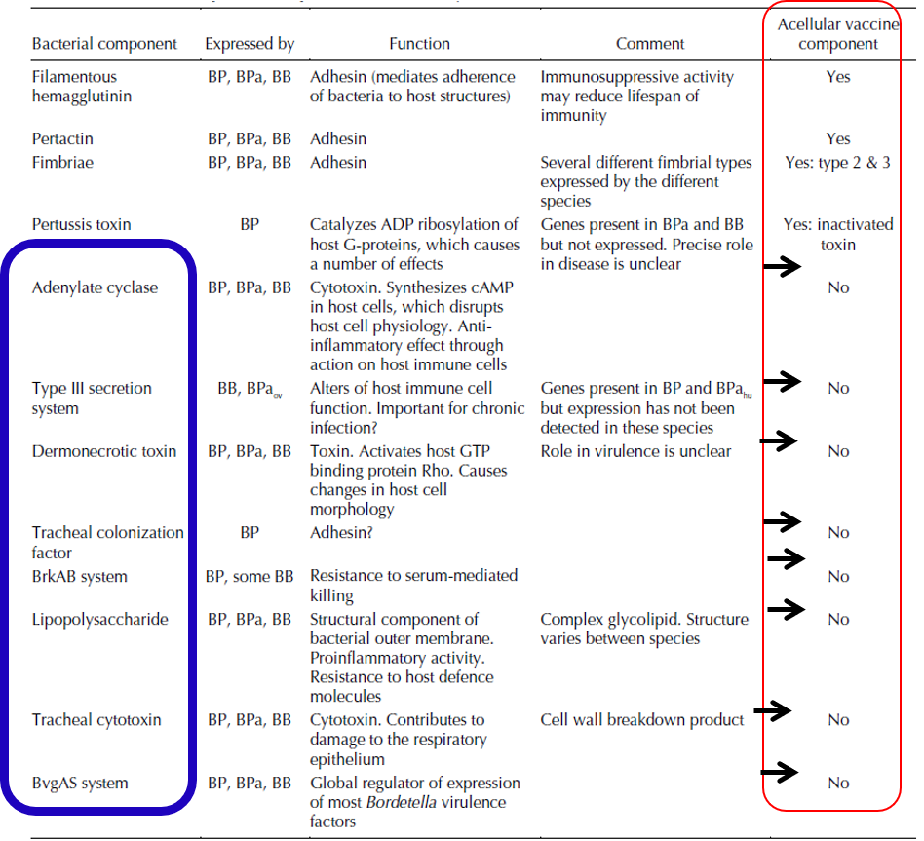
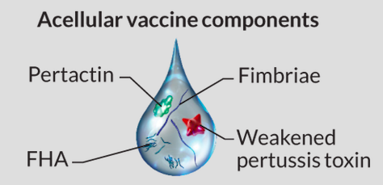
1. Limited Antigenic Components in aP Vaccines
aP vaccines do not contain multiple crucial antigens, while wP vaccines contain entire complement of antigens.
Antigenic components missing in aP Vaccine
Available Components of aP:
India: 2–3 components
USA/Europe: 5 components
BP: Bordetella pertussis, Bpa: B. parapertussis, Bpaov: Ovine-adapted B. parapertussis, Bpahu: Human-adapted B. parapertussis, BB = B. bronchiseptica; USA: United States of America.
Peterson A. CMAJ. 2005;173(1):55–62.
Notes:
Multiple virulence factors responsible for pertussis pathogenesis.¹ Limited antigenic components in acellular pertussis vaccine is another major reason for reason for waning protection with this form of vaccine. The table in the slide depicts the components that are missing in aP vaccine.²
Reference
He Q, Makinens J, Barber G, et al. Bordetella pertussis protein pertactin induces type-specific antibodies: one possible explanation for the emergence of antigenic variants? J Infect Dis. 2003;187(8):1200–1205.
Peterson A. Bordetella pertussis: The intersection of genomics and pathobiology. CMAJ. 2005;173(1):55–62.

Slide 12



2. Mismatch Between Antigen in Vaccine and Current Antigen Strain
Genetic changes
Vaccine escape mutants
Allelic mismatch
B. pertussis strains show genetic selection for “vaccine escape mutants,” with changes in vaccine antigen-expressing genes, increasing the virulence of pathogen.¹
Significant genetic changes have taken place in circulating B. pertussis strains vs. pre-vaccine era strains and whole-cell vaccine era strains.¹
Genetic divergence of circulating B. pertussis away from vaccine reference strains led to allelic mismatch.²
Adaption by the pathogen, likely from vaccine pressure, has led to the divergence of vaccine strains from circulating strains.³
Carbonetti N. Curr Opin Infect Dis. 2016;29(3):287–294.
Weigand M, et al. Emerg Infect Dis. 2019;25(4):780–783.
Bart M, et al. mBio. 2014;5(2):e01074.
Notes:
This slide will highlight another aspect for waning protection of acellular pertussis vaccine.
Circulating B. pertussis strains have undergone significant genetic changes compared to pre-vaccine era strains and whole-cell vaccine era strains.¹
B. pertussis strains show genetic selection for “vaccine escape mutants”, with changes in vaccine antigen-expressing genes, increasing increased the virulence of pathogen.¹
Genetic divergence of circulating B. pertussis away from vaccine reference strains led to allelic mismatch and rapid emergence of pertactin deficiency.²
Adaption by the pathogen, likely from vaccine pressure, has led to the divergence of vaccine strains from circulating strains.³
References
Carbonetti NH. Bordetella pertussis: New concepts in pathogenesis and treatment. Curr Opin Infect Dis. 2016;29(3):287–294.
Weigand MR, Williams MM, Peng Y, et al. Genomic survey of Bordetella pertussis Diversity, United States, 2000–2013. Emerg Infect Dis. 2019;25(4):780–783.
Bart MJ, Harris SR, Advani A, et al. Global population structure and evolution of Bordetella pertussis and their relationship with vaccination. mBio. 2014;5(2):e01074.

Slide 13
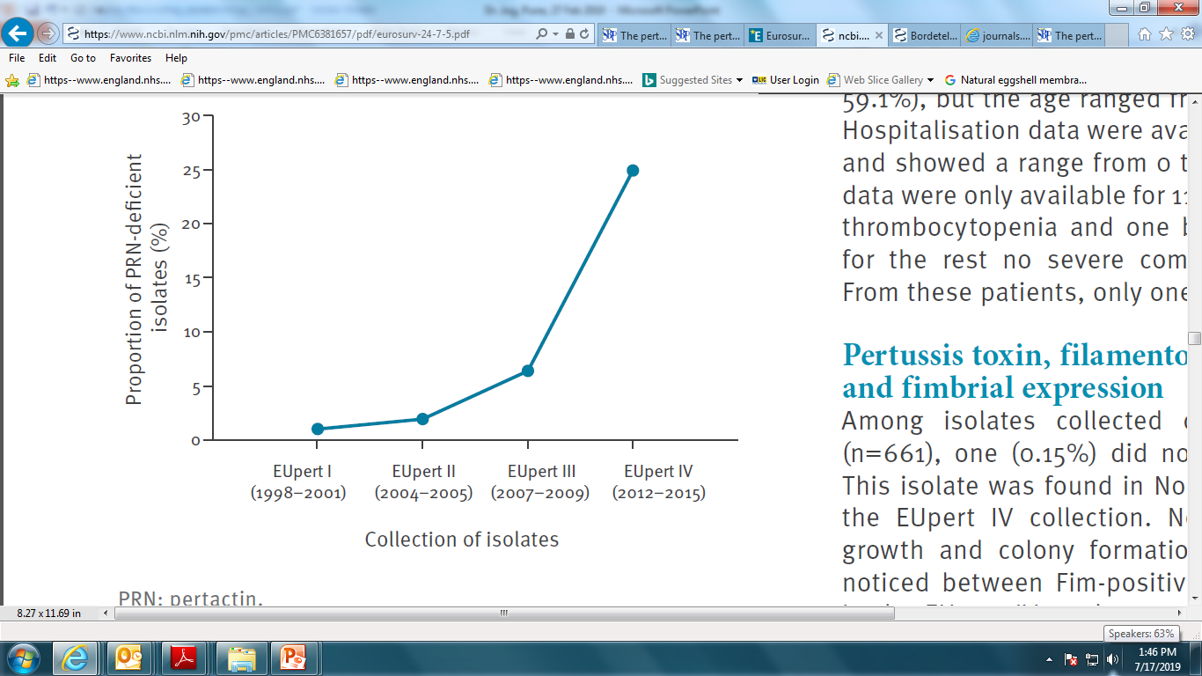
2. Mismatch Between Antigen in Vaccine and Current Antigen Strain
Proportion of pertactin-deficient isolates in EUpert I–IV collections, Europe, 1998–2015 (n=661 isolates)
The prevalence of PRN-deficient B. pertussis isolates was increased in Europe, and the rising trend was associated with the time since the introduction of acellular vaccine.
Increase in PRN-deficient Isolates
Barkoff A, et al. Euro Surveill. 2019;24(7):1700832.
PRN: Pertactin.
Notes:
In Europe, the high prevalence of pertactin (PRN)-deficient Bordetella pertussis isolates has been found following usage of acellular pertussis (aP) vaccine. In Europe, a study was conducted to evaluate whether proportions of PRN-deficient strains increased in consecutive collections of B. pertussis clinical isolates and if the frequency of PRN-deficient strains in countries correlated with the time since ACV introductionB. pertussis clinical isolates were obtained from different European countries during four periods (EUpert I–IV studies): 1998 to 2001 (n=102), 2004 to 2005 (n=154), 2007 to 2009 (n=140), and 2012 to 2015 (n=265). In EUpert I, one (1.0%; 1/102; Sweden (n=1)) PRN-deficient isolate was found. In EUpert II three (1.9%; 3/154; France (n=1), Germany (n=1), the Netherlands (n=1), and in EUpert III nine (6.4%; 9/140; France [n=5], Norway [n=3], Sweden ]n=1]) such isolates were detected. In EUpert IV, 66 (24.9%; 66/265) isolates were deficient for PRN. The prevalence of PRN-deficient B. pertussis isolates has increased in Europe and the increase seems to be associated with the time since the introduction of acellular vaccine.
Reference
Barkoff AM, Mertsola J, Pierard D, et al. Pertactin-deficient Bordetella pertussis isolates: evidence of increased circulation in Europe, 1998 to 2015. Euro Surveill. 2019; 24(7): 1700832.

Slide 14
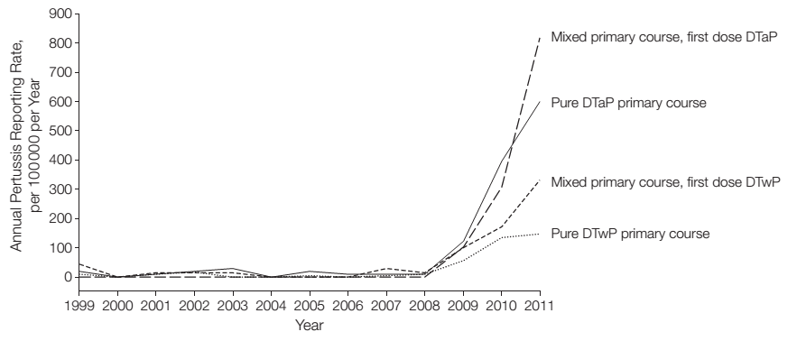
Shift From wP to aP Vaccine and Consequences
3. Waning Efficacy of Acellular Pertussis Vaccine
Pertussis reporting rates between 1999 and 2011 by primary course of pertussis vaccination for children born in 1998, in Queensland
Infants primed with aP vaccine are 8X more likely to develop pertussis infection
Infant priming with DTwP associated with a lower risk of subsequent pertussis than DTaP only primed children. A primary course using moderately effective DTwP vaccine may be more protective than DTaP.
Sheridan S, et al. JAMA. 2012;308(5):454–456.
Notes:
In continuation with previous slide, this slide depicts the consequence of shifting from whole-cell pertussis (wP) to acellular pertussis (aP) vaccine. In March’1999, Queensland, Australia, DTwP vaccines were replaced by DTaP vaccine owing to adverse events caused by the former one. DTaP vaccine program was implemented for publicly funded primary course immunizations delivered at ages 2 months, 4 months, and 6 months. This meant children born in 1998 could receive a primary course consisting of only DTwP, only DTaP, or a mixed schedule. For children born in 1998, a study was conducted to report the pertussis rates, in both the pre-epidemic (1998–2008) and outbreak periods (2009-2011), by number and order of DTwP doses given before their first birthday. Data was collected data from the Queensland vaccination register (QVR) with case reports of pertussis. Among 58,233 children born in 1998 identified in the QVR, 40,494 (69.5%) received at least 3 doses of any pertussis containing vaccine during the first year from a Queensland vaccine service provider and were included in the analysis. Overall, 267 first pertussis cases were reported from this cohort between 1999 and 2011. Children who received a 3-dose DTaP primary course had higher rates of pertussis than those who received a 3-dose DTwP primary course in the pre-epidemic and outbreak periods. Among those who received mixed courses, rates in the current epidemic were highest for children receiving DTaP as their first dose. Infant priming with DTwP was associated with a lower risk of subsequent pertussis than DTaP only primed children in this cohort. This difference persisted for more than a decade, being evident in pre-epidemic and outbreak periods. A primary course using even a moderately effective DTwP vaccine may be more protective than DTaP.
Reference
Sheridan SL, Ware RS, Grimwood K, et al. Number and order of whole cell pertussis vaccines in infancy and disease protection. JAMA. 2012;308(5):454–456.

Slide 15
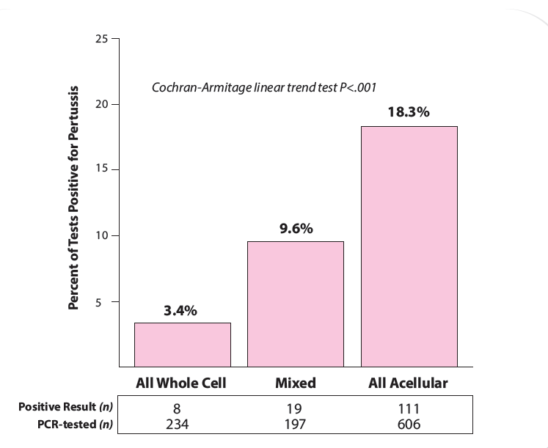
3. Waning Efficacy of Acellular Pertussis Vaccine
Teenagers vaccinated with 4 doses of DTaP vaccines were almost 6 times higher risk of pertussis than those who had received 4 doses of DTwP vaccines.
Decreasing number of DTwP doses was significantly associated with increased pertussis risk (P < .0001).
Teenagers who received DTwP vaccines in childhood were more protected against pertussis outbreak than were those who received DTaP vaccines.
Pediatrics 2013; 131(6):e1716-22

Slide 16
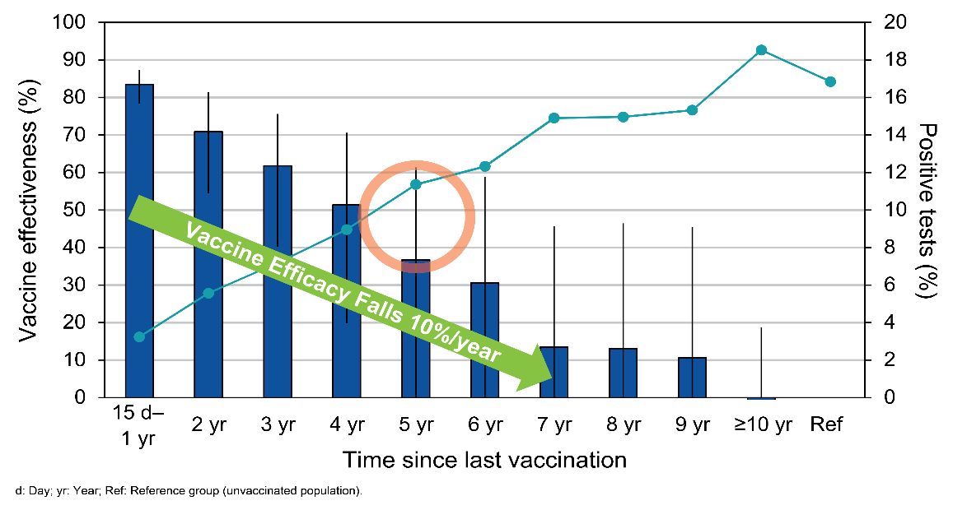
Declining Protection From aP Vaccines
3. Waning Efficacy of Acellular Pertussis Vaccine
Effectiveness of pertussis vaccination and duration of immunity.
As time from last vaccination increased, aP vaccine effectiveness decreased, and the proportion of tests positive for pertussis increased..
Whole-cell vaccine priming may be considered for optimized pertussis control.
Pertussis-vaccine effectiveness (blue bars, left axis) and proportion of positive tests (solid line, right axis) by year since last vaccination in participants with up-to-date or partial vaccination.
wP: Whole-cell pertussis; aP: Acellular pertussis.
Schwartz K, et al. CMAJ. 2016;188(16):E399–E406.
Notes:
A resurgence of pertussis cases among both vaccinated and unvaccinated people raised doubts on efficacy of vaccine over time. Therefore, a case–control study was conducted to evaluate the effectiveness of the pertussis vaccine and characterize the effect of waning immunity and whole-cell vaccine priming. Multivariable logistic regression models were constructed to estimate odds ratios (ORs). The waning immunity was assessed by calculating the odds of developing pertussis per year since last vaccination and evaluated the relative effectiveness of priming with acellular versus whole-cell vaccine. Data on 5867 individuals (486 test-positive cases and 5381 test-negative controls) were considered for the final analysis. Since last vaccination, the adjusted vaccine effectiveness was found to be 80% at 15–364 days, followed by 84%, 62%, and 41% at 1–3 years, 4–7 years, and ≥8 or more years interval, respectively. Acellular, versus whole-cell, vaccine priming was associated with an increased odd of pertussis (adjusted odd ratio 2.15, 95% Confidence interval 1.30 to 3.57). the study analysis depicted high early efficacy of the pertussis vaccine that eventually went into a declining trend over time since last vaccination and this outcome was especially evident with acellular vaccine priming. The findings highlight the need of considering whole-cell vaccine priming and/or boosters in pregnancy for optimized pertussis control.
Reference
Schwartz KL, Kwong JC, Deeks SL, et al. Effectiveness of pertussis vaccination and duration of immunity. CMAJ. 2016;188(16):E399–E406.

Slide 17
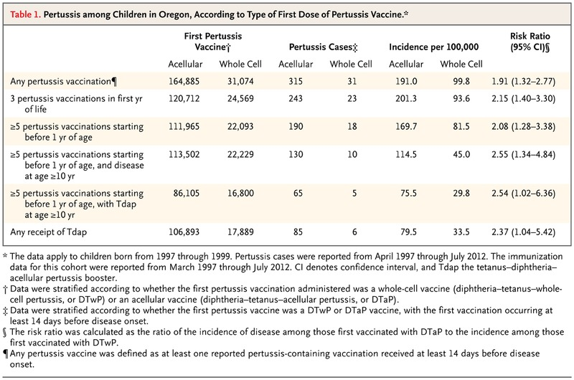
3. Waning Efficacy of Acellular Pertussis Vaccine
Pertussis among Children in Oregon, According to Type of First Dose of Pertussis Vaccine.*
The reported rates of pertussis were significantly lower among children who had started the vaccination process with DTwP than among those who had started with DTaP.
* The data apply to children born from 1997 through 1999. Pertussis cases were reported from April 1997 through July 2012. The immunization data for this cohort were reported from March 1997 through July 2012. CI denotes confidence interval, and Tdap the tetanus–diphtheria– acellular pertussis booster. † Data were stratified according to whether the first pertussis vaccination administered was a whole-cell vaccine (diphtheria–tetanus–wholecell pertussis, or DTwP) or an acellular vaccine (diphtheria–tetanus–acellular pertussis, or DTaP). ‡ Data were stratified according to whether the first pertussis vaccine was a DTwP or DTaP vaccine, with the first vaccination occurring at least 14 days before disease onset. § The risk ratio was calculated as the ratio of the incidence of disease among those first vaccinated with DTaP to the incidence among those first vaccinated with DTwP. ¶Any pertussis vaccine was defined as at least one reported pertussis-containing vaccination received at least 14 days before disease onset.
Liko J, et al. N Engl J Med. 2013;368(6):581–582.
DTaP: Diphtheria, tetanus, and acellular pertussis; DTwP: Diphtheria, tetanus, and whole-cell pertussis.
Notes:
Pertussis cases from statewide surveillance and immunization records from Oregon’s population-based immunization information system, ALERT IIS, were reviewed for children born in Oregon in the years 1997 through 1999. ALERT IIS holds pertussis immunization records for 195,959 children born from 1997 through 1999. From April 1997 through July 2012, a total of 484 cases of pertussis were reported, of which 402 (83%) could be matched to ALERT IIS pertussis vaccination records; 346 of these children had been vaccinated 14 days or more before disease onset. In all scenarios, the reported rates of pertussis were significantly lower among children who had started the vaccination process with DTwP than among those who had started with DTaP.
Reference
Liko J, Robinson SJ, Cieslak PR. Priming with whole-cell versus acellular pertussis vaccine. N Engl J Med. 2013;368(6):581–582.

Slide 18
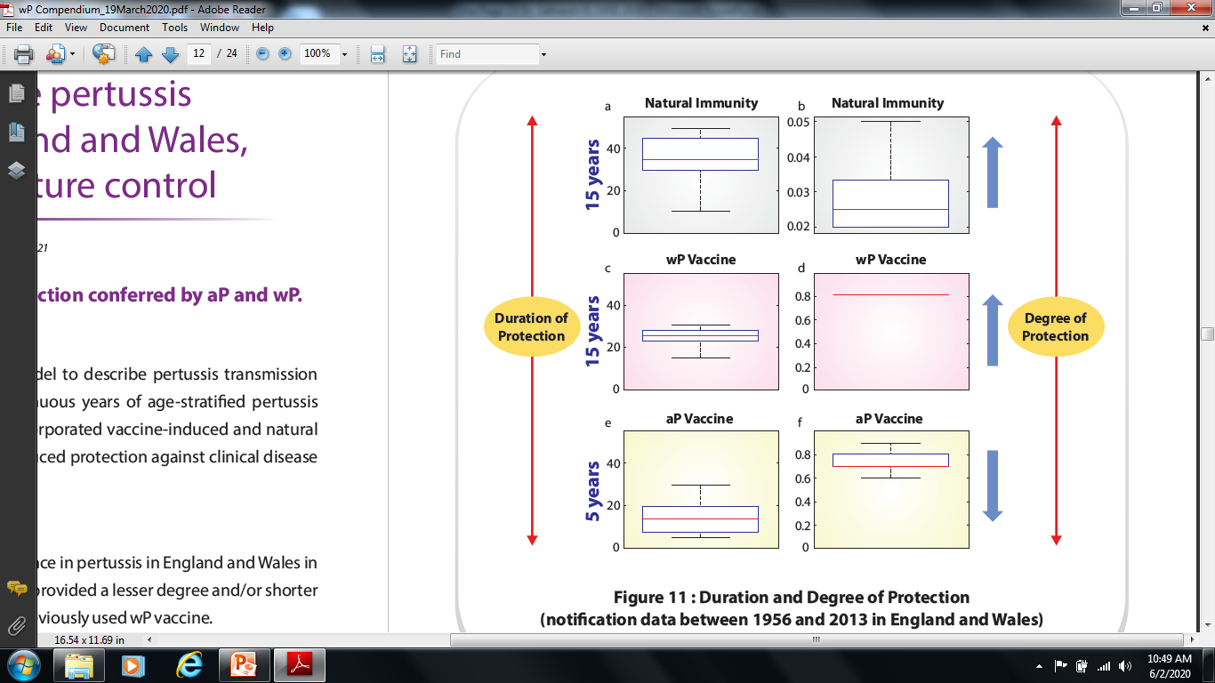
4. Duration of Protection with aP Vaccines
Duration of protection conferred by aP and wP vaccines
Duration of protection for natural and wP-induced immunity was at least 15 years, but aP vaccine could be as low as 5 years.
WHO recommends countries currently using wP vaccine for primary immunization should not change to aP vaccine.
a Duration of natural immunity; b α2/α1; c duration of wP vaccine protection; d degree of whole cell vaccine protection against infection; e duration of aP vaccine protection; f degree of acellular vaccine protection against infection. Red line for median, blue box for lower and upper quartiles and black bars for minimum and maximum
Choi Y, et al. BMC Med. 2016;14(1):121.
WHO: World Health Organization; aP: Acellular pertussis; wP: Whole-cell pertussis.
Notes:
In 2012 England and Wales experienced a resurgence of pertussis and an increase in infant deaths. This occurred eight years after acellular pertussis (aP) vaccine replaced whole cell (wP) primary vaccine despite continued high coverage for the primary series and pre-school aP booster. A mathematical model was developed to describe pertussis transmission dynamics in England and Wales since the 1950s and the model was used to investigate the cause of the resurgence and the potential impact of additional vaccination strategies. An age-structured, compartmental, deterministic model of the pertussis transmission dynamics was fitted to 60 continuous years of age-stratified pertussis notification data in England and Wales. The model incorporated vaccine-induced and natural immunity and differentiated between vaccine-induced protection against clinical disease and infection. In the simulations, the degree of protection of wP against infection was estimated to be at least 80%, which accords with the estimate of 85 % from a household contact study in Senegal for one of the wP vaccines that has been used in the national programme in the United Kingdom (UK). In contrast, the degree of protection for aP could be as low as 60%. The degree of protection of wP vaccine against infection was estimated to be higher than that of aP vaccine. Duration of protection for natural and wP-induced immunity was at least 15 years, but aP vaccine could be as low as 5 years. World Health Organization recommends countries currently using wP vaccine for primary immunization should not change to aP vaccine.
Reference
Choi YH, Campbell H, Amirthalingam G, et al. Investigating the pertussis resurgence in England and Wales, and options for future control. BMC Med. 2016;14(1):121.

Slide 19
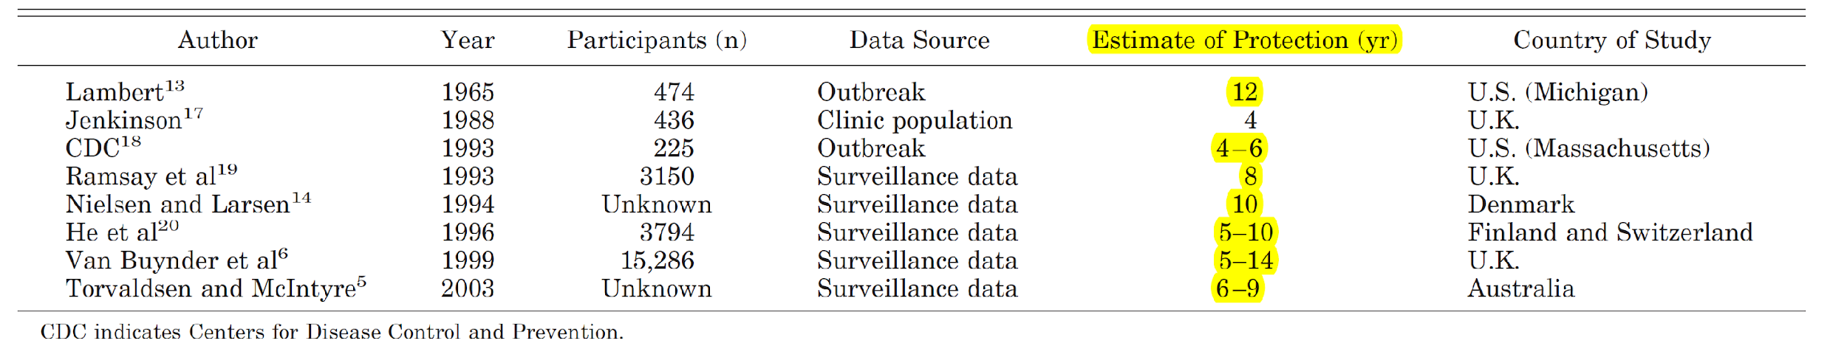
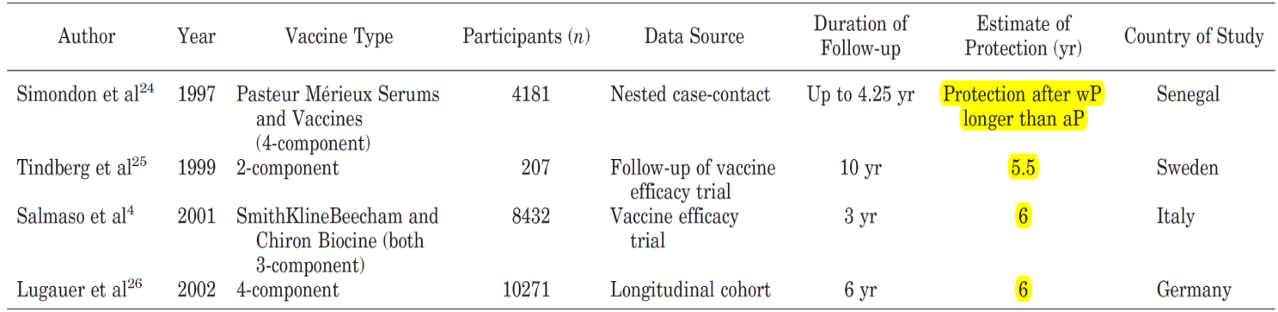
4. Duration of Protection with aP Vaccines
wP vaccines provide longer immunity than aP vaccines …
Duration of protection by wP vaccines
Infection/Vaccination | Range of Protection
Natural Infection | 3.5 - 12 years
wP Vaccination | 4 - 15 years
aP Vaccination | 3 – 5 years
Degree of Protection
wP > aP
Source: 1. Pediatric Infectious Diseases Journal 2005;24(5) 58-61. 2. Wendelboe et al. PIDJ, 2005.

Slide 20




“Baboon Study”
5. Immunological Distinction between wP & aP Vaccine
WHAT BABOONS HAS TO DO WITH PERTUSSIS.... & WHY BABOONS

Slide 21
5. Immunological Distinction between wP & aP Vaccine
Baboon Study 1 : Baboon Acellular pertussis vaccines protect against disease but fail to prevent infection and transmission in a nonhuman primate model. Proc Natl Acad Sci U S A. 2014.
Baboon Study 2 : Comparison of Three Whole-Cell Pertussis Vaccines in the Baboon Model of Pertussis. Clinical & Vaccine Immunology: 2016.
Baboon Study 3 : Immunological Distinctions between Acellular and Whole-Cell Pertussis Immunizations of Baboons Persist for at Least One Year after Acellular Vaccine Boosting. Vaccines : 2020.

Slide 22
Why Baboons for Pertussis Infection Study???
Studies in humans are difficult due to the low frequency of pertussis in the population, the cyclical nature of incidence and the sporadic geographic distribution of cases.
Experiments on Nonhuman primates have brought important advances in biology and medicine understanding the pathogenesis of pertussis.
Close evolutionary relationship to humans, primates often play a crucial role in research aimed at understanding, preventing, and treating infectious diseases in humans.
The baboon model of pertussis recapitulates the full spectrum of human pertussis including coughing and transmission.
Baboons are non-human primates which has > 96% genetic similarity with humans.

Slide 23
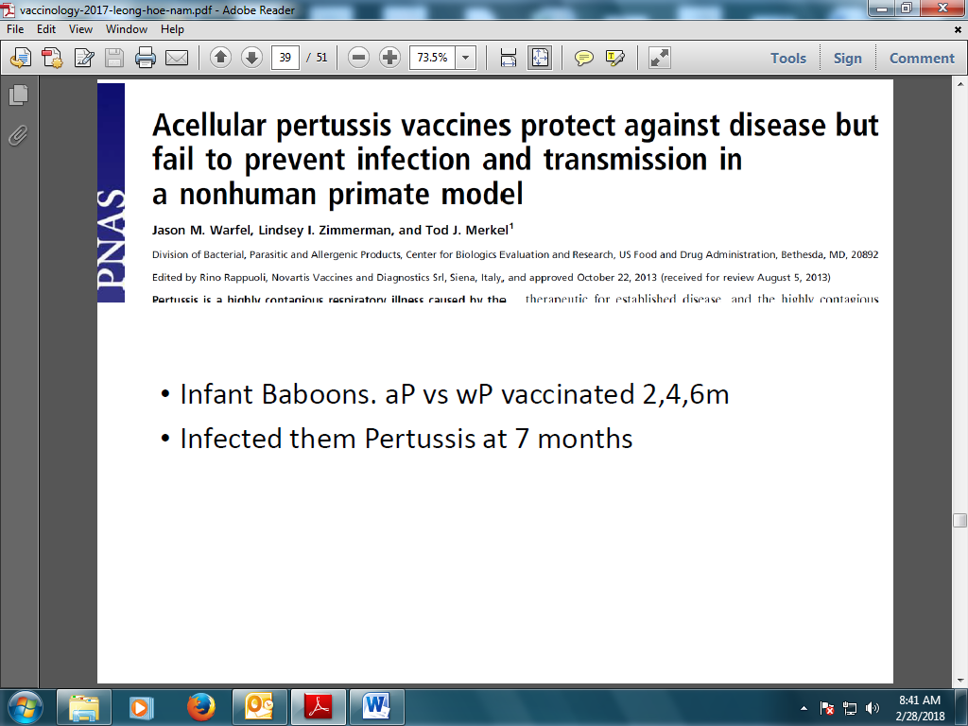

Baboon Study 1
Baboons are non-human primates which has > 96% genetic similarity with humans.
Infant baboon vaccinated with aP and wP vaccines on 2, 4 and 6 months.
Baboons infected with Pertussis bacteria at 7 months.
WHAT BABOONS HAS TO DO WITH PERTUSSIS.... & WHY BABOONS

Slide 24
To assess the ability of wP or aP vaccine to prevent colonization and clinical pertussis symptoms
wP or aP Vaccine
2 month
4 month
6 month
7 month
After 2 Weeks
Circulating white blood cells
Nasopharyngeal washes (quantify bacterial cell counts)
Peripheral Blood Mononucleated cells (T-cell responses)
Serum separation (Serum antibodies against pertussis Antigen)
Infant Baboon
Challenged with D420, a B. pertussis
clinical isolate

Slide 25
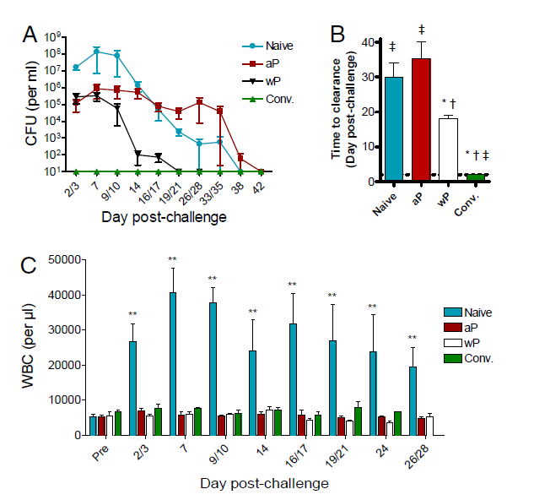
Effect of vaccination on colonization and Leukocytosis
Colonization
Clearance of Infection
Infection

Slide 26
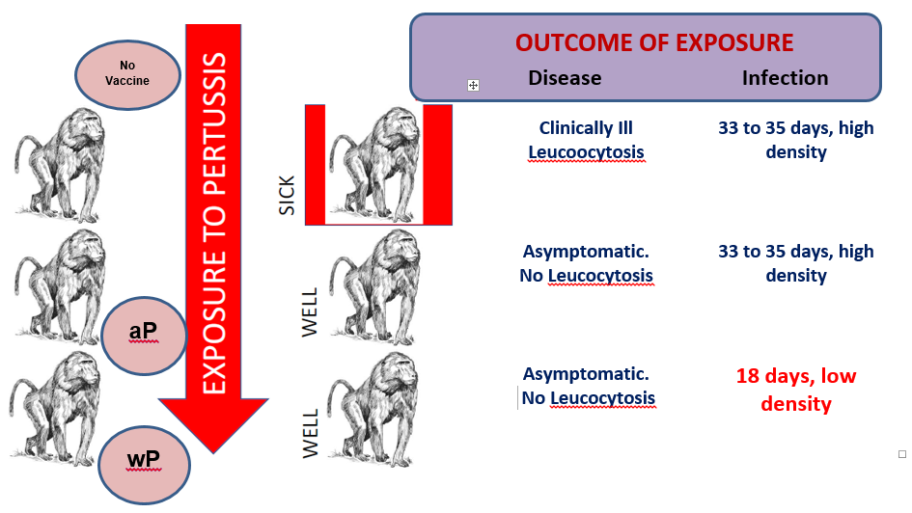
Exposure of Pertussis Among aP or wP Vaccinated or Unvaccinated Infant Baboons
aP and wP vaccines prevented clinical _{disease.}
aP has infection, but no clinical disease.
aP persistence in mucosa, which may transmit the infection.
aP vaccine had no impact on duration of infection.
wP shorten duration of infection and had lower bacterial count.

Slide 27
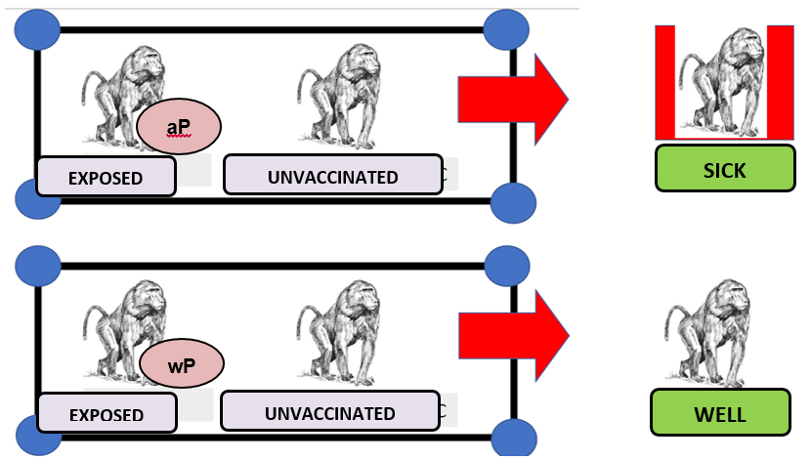
aP Vaccinated baboons did not developed symptomatic disease but they can shed the bacteria and spread to others (unvaccinated or uninfected baboons)

Slide 28
Results of aP VS wP in Baboon Study
ACELLULAR (aP) | WHOLE CELL (wP)
Protected from severe pertussis-associated symptoms. Failed to prevent infection. | Protected from pertussis symptoms
Failed to clear the infection faster than naïve (uninfected) animals. | Rapid clearance. Faster than naïve animals.
Colonization­­. | Cleared infection and colonization.
Transmitted pertussis to unvaccinated contacts. | No transmission of pertussis to unvaccinated contacts.
Absence of mucosal immunity induction. | Induces robust mucosal immunity.
Induces Th2 response. | Induces robust Th1/Th17 response.

Slide 29
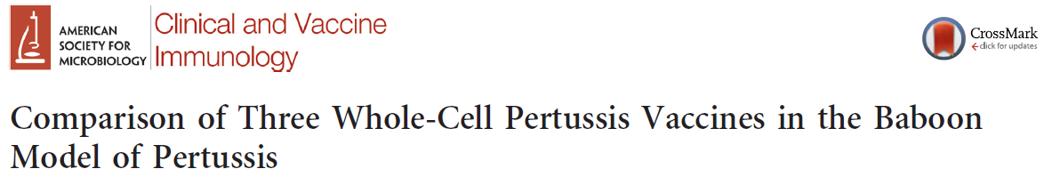
Baboon Study 2
To Compare efficacy of 3 marketed (outside US) DTwP-based Vaccines (Triple Antigen (Serum Institute of India), DT-COQ (Sanofi Pasture, France) & Quinvaxen, (Crucell-Janssen, South Korea)) with US marketed 5-component DTaP-based Vaccine (Daptacel (Sanofi Pasteur, Canada).
wP or aP Vaccine
2 month
4 month
6 month
7 month
After 2 Weeks
B. pertussis colonization and pertussis symptoms
Memory cytokines response following pertussis challenge
Infant Baboon
Challenged with D420, a B. pertussis
clinical isolate
Clinical and Vaccine Immunology 2016; 23(1)

Slide 30
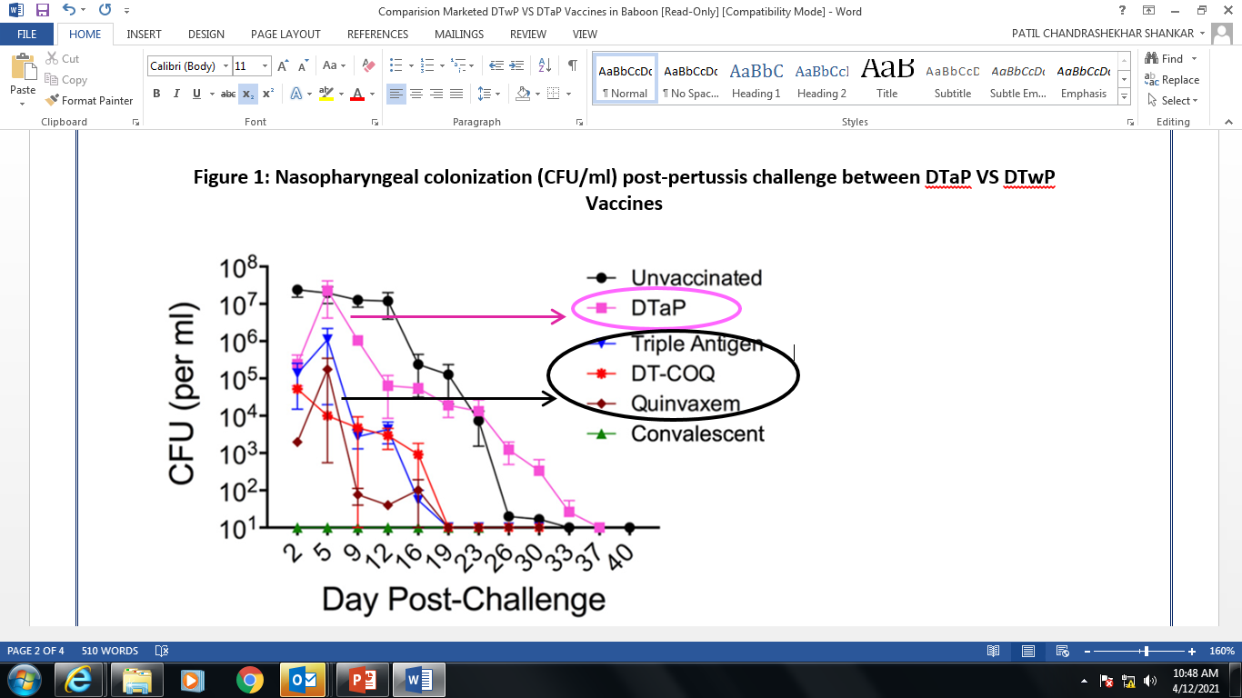
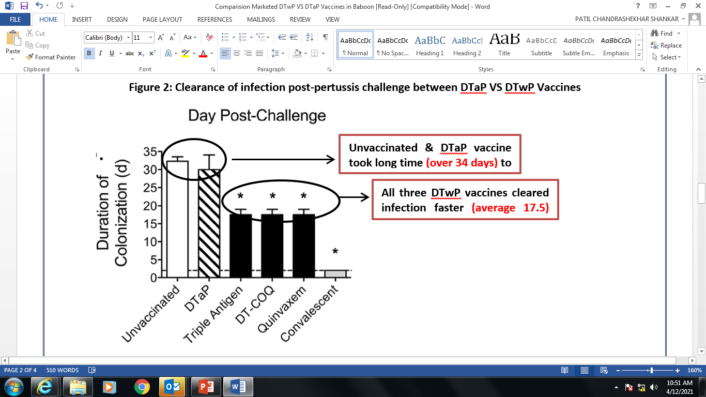
Nasopharyngeal colonization (CFU/ml) post-pertussis challenge between DTaP VS DTwP Vaccines
Clearance of infection post-pertussis challenge between DTaP VS DTwP Vaccines
DTaP vaccine exhibited delayed clearance of nasopharyngeal colonization (CFU/ml) compared to all three DTwP-based vaccines post-pertussis challenge.
All three DTwP vaccine cleared pertussis colonization or infection faster (average 17.5 days) compared to (DTaP) and unvaccinated animals (over 34 days).

Slide 31
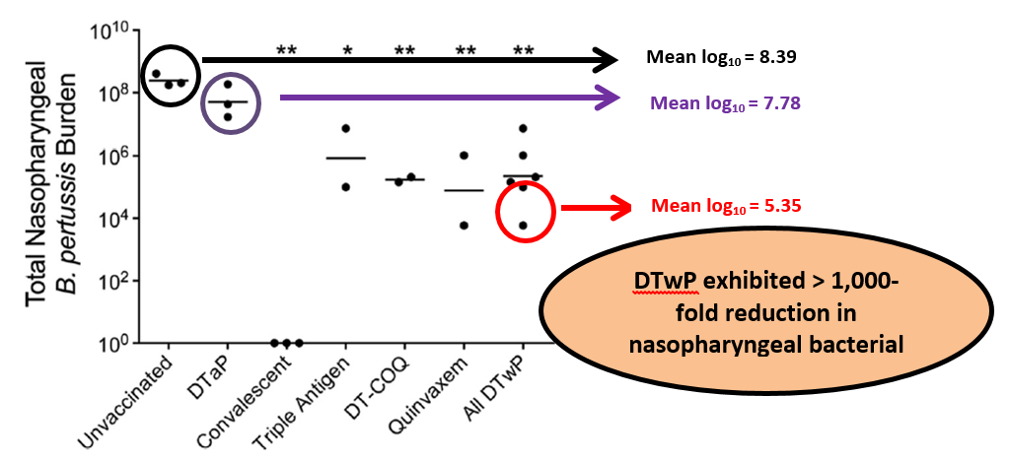
Total nasopharyngeal bacteria burden between DTaP VS DTwP Vaccines
DTwP vaccines showed > 1,000-folds reduction in nasopharyngeal bacterial count, thereby, decreasing the opportunity of B. pertussis transmission compared to DTaP vaccines or no vaccination

Slide 32
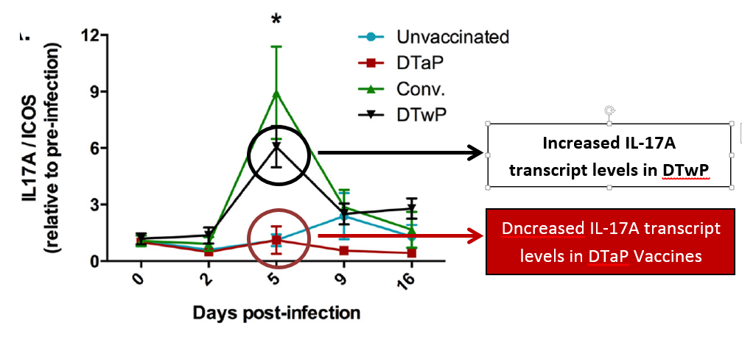
Cytokines response post-infection DTaP VS DTwP Vaccines
DTwP vaccines exhibited increased cytokines (IL-17A) post-infection indicating, DTwP vaccines induces pronounced Th17 and Th1 memory response.

Slide 33
Results of aP VS wP in Baboon Study
Nasopharyngeal colonization (CFU/ml) clearance post-pertussis challenge decreased slowly in unvaccinated and DTaP vaccine treated groups compared to all three DTwP-based vaccines.
Unvaccinated and DTaP vaccinated animals took twice as long time to clear the infection as compared to three DTwP based vaccines (average 17.5 days) .
DTwP vaccines exhibited > 1,000-fold reduction in total nasopharyngeal bacterial.
Post-pertussis challenge interleukin-17A (IL-17A) transcript level increased in DTwP-based vaccines compared to DTaP and unvaccinated groups.

Slide 34
Conclusion
All three DTwP vaccines exhibited following:
Clearance of pertussis infection faster,
Prevention of symptoms, colonization and transmission and
Increased the cytokine (IL-A) expression.
DTwP vaccines induced the protective response by Th17 immune response and formation of opsonizing antibodies offering long term protection.

Slide 35
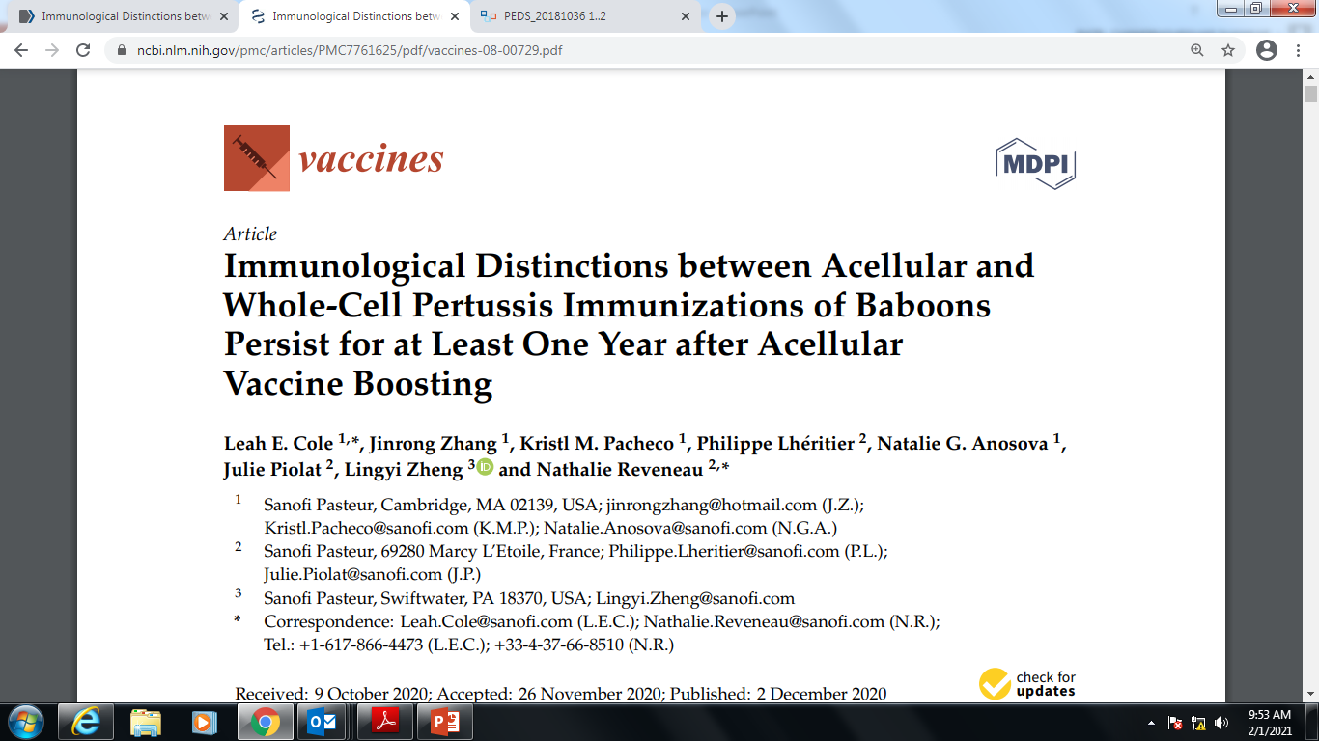
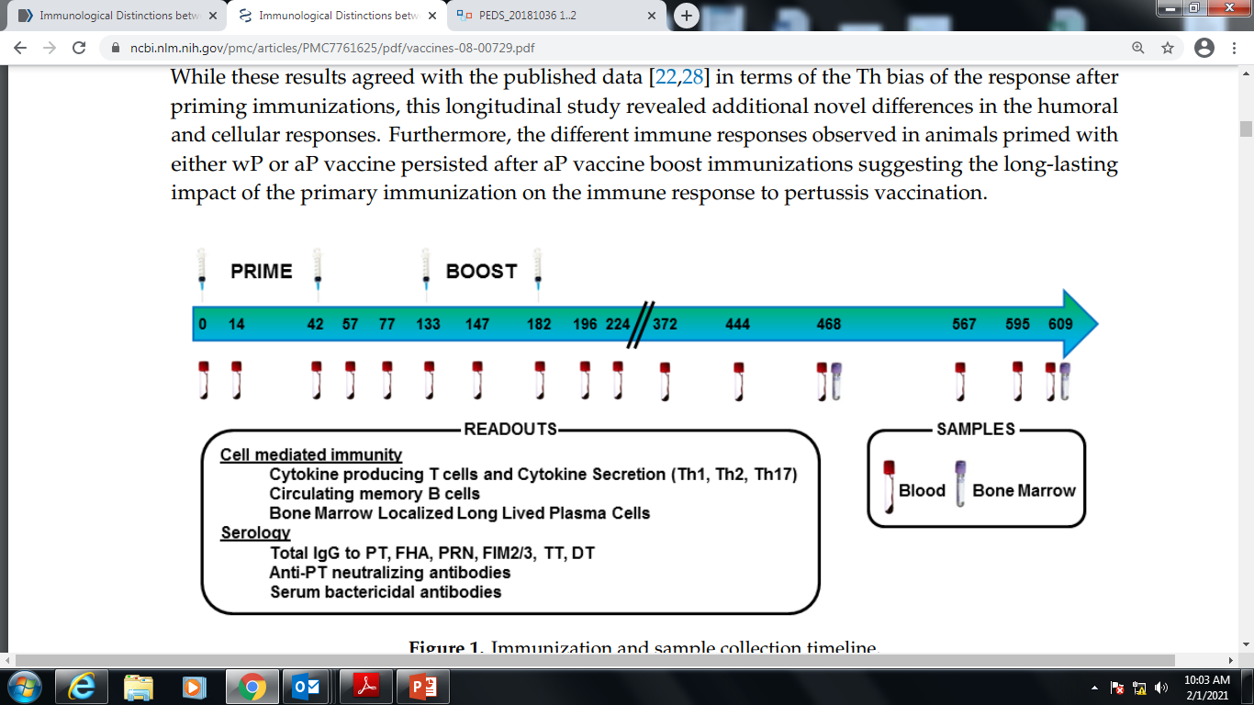
Baboon Study 3
To examine immune signatures associated with the aP and wP vaccine priming and boosting over an extended period of time
wP and aP
aP
Baboon are preclinical model of pertussis as it recapitulate the full spectrum of human disease symptoms
Vaccines 2020, 8, 729

Slide 36
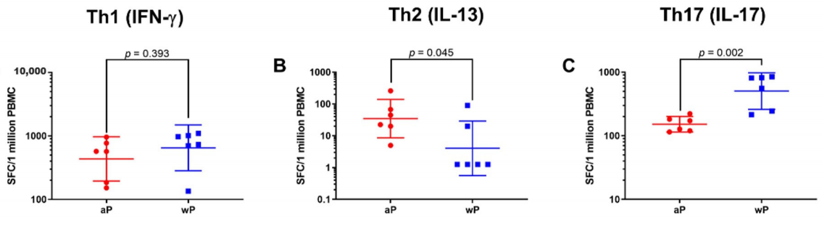
T-Cell Secretion
↑ wP Vaccine
↓ wP Vaccine
↑ wP Vaccine
wP Vaccine
aP Vaccine
Animals Primed with wP Vaccine Exhibited a more Th17 biased Response than Animals Primed with aP Vaccine
While Priming with aP Vaccine Led to a more Th2 biased Response than wP Vaccine Priming
Vaccines 2020, 8, 729

Slide 37
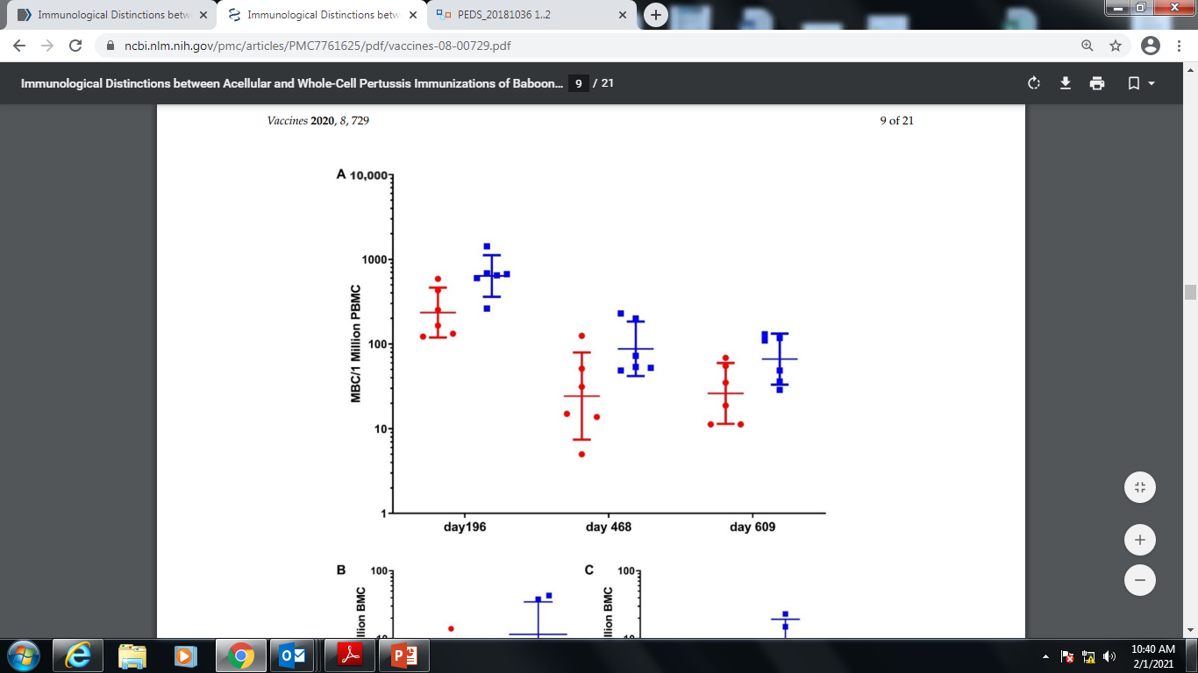
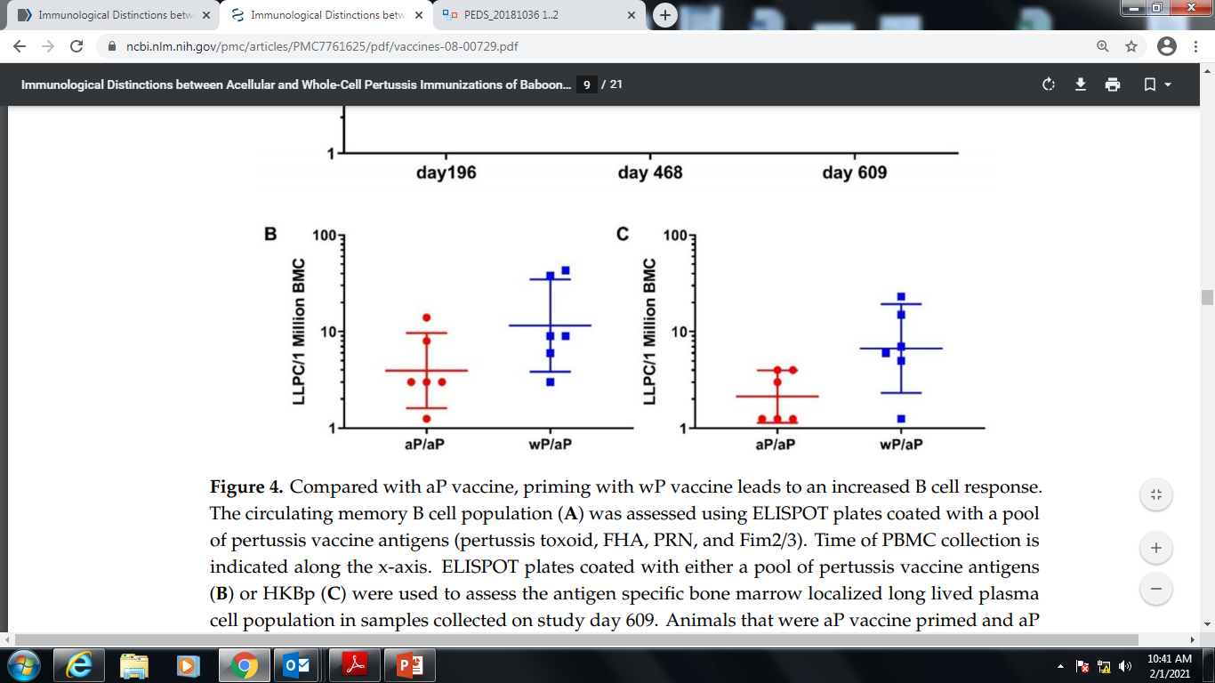
B-Cell Memory Response
B-Cell (Memory & Plasma) Responses
2.67-fold
wP Vaccine
3.52-fold
2.53-fold
aP Vaccine
Compared with aP vaccine, priming with wP vaccine leads to an 2.67-, 3.52- and 2.53-fold increased B cell response on day 196, 468 and 609, respectively..
B-Cell Plasma Cell Response
Long lived Plasma Cell on day 609, was 11.4 and 3.6 for wP/aP and aP/aP, respectively.
Priming with wP Vaccine Increase the Pertussis Specific Circulating Memory B Cell and Bone Marrow Localized Long Lived Plasma Cell Populations Compared to aP Vaccine

Slide 38
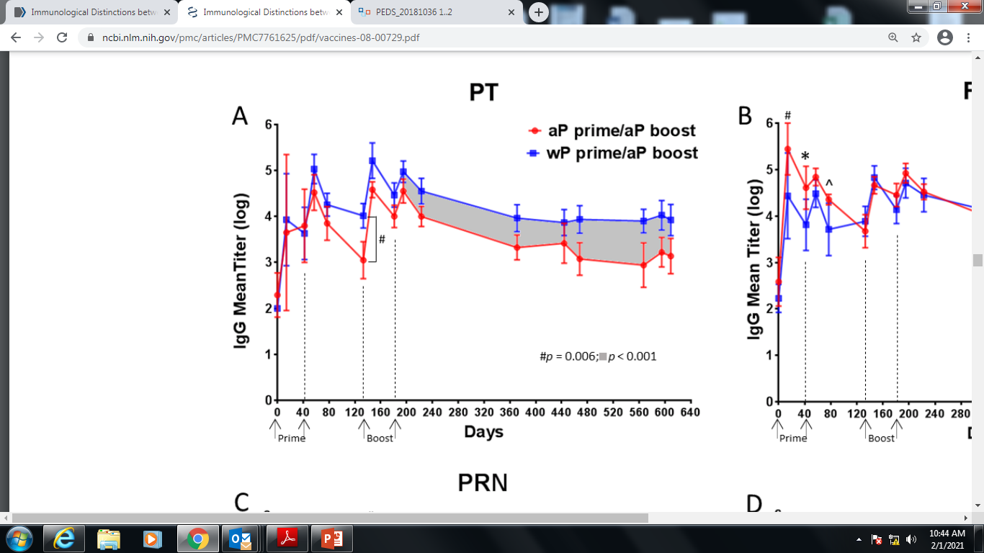
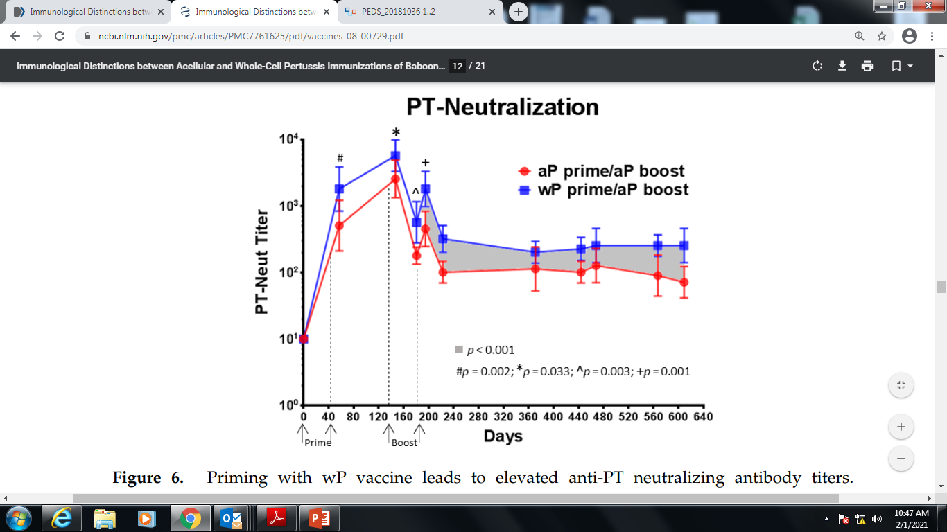
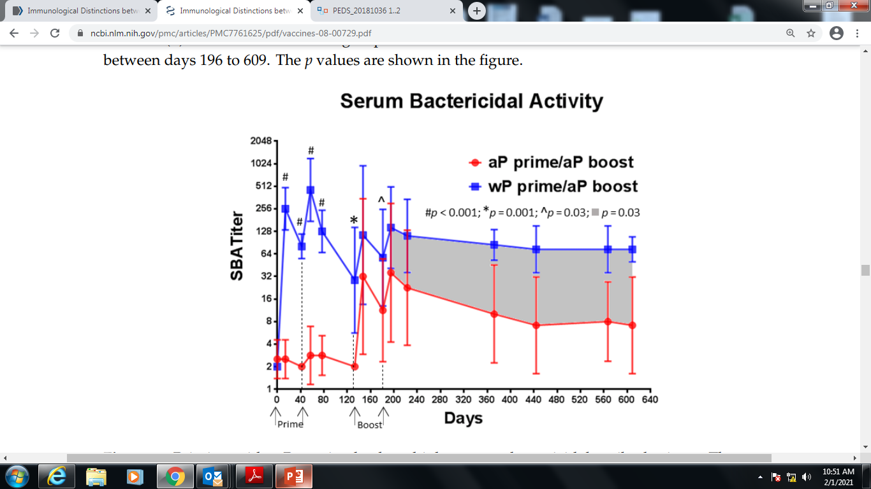
Anti-PT & SBA Responses
Higher Anti-PT IgG Response Sustained in wP-Primed Baboons Compared to aP-Primed for 14 Months Following Boost
Priming with wP vaccine leads to elevated anti-PT neutralizing antibody titers
Priming with wP vaccine leads to higher Serum Bactericidal Activity (SBA)
Vaccines 2020, 8, 729

Slide 39
Conclusion
Priming with a wP vaccine elicited a more Th17-biased response than priming with aP, whereas priming with an aP vaccine led to a more Th2-biased response than priming with wP.
Compared to aP, animals primed with a wP vaccine exhibited greater numbers of pertussis specific memory B cells.
aP and wP vaccine priming initially elicited similar levels of anti-pertussis toxin antibody, titers declined more rapidly in aP vaccine primed animals leading to a 4-fold difference.
Both wP and aP vaccine immunization could induce serum bactericidal activity (SBA); however, only one wP vaccine immunization was required to elicit SBA while multiple aP vaccine immunizations were required to elicit lower, less durable SBA titers.
aP & wP vaccine elicits distinct cellular and humoral immune responses that persist after aP vaccine boosting
Vaccines 2020, 8, 729

Slide 40
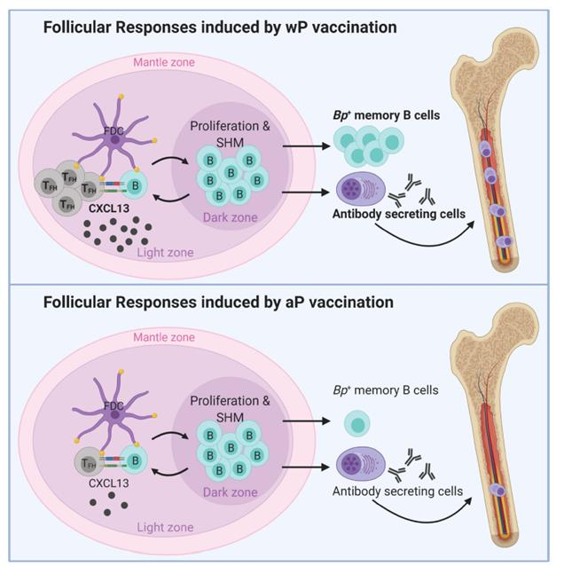
Important differences in the immunological signatures triggered by aP and wP vaccination
wP vaccine compared to aP was characterized by Stronger:
TFH cell responses,
CXCL13 production,
B. pertussis+ MBCs, and
Anti-B. pertussis antibody secreting cells
Conclusion
wP vaccine response was characterized by increased markers of immune signatures: T cell follicular response, CXCL13, circulating B. pertussis+ MBCs and pertussis specific antibody titers leading to longevity of memory response.
Frontiers in Immunology, 2022

Slide 41
Increased macrophage & neutrophil recruitment
Th1
Increased pertussis specific antibody IgG2a, IgG1, IgG4
Th2
Limited protective role
TRM
Naïve CD4+ T Cell
Increased functional antibody (opsonization, neutralization
PROTECTION against INFECTION & DISEASE
Th17
Increased neutrophil activation
Treg
Whole-cell Vaccine
Reduced Suppression
Increased pertussis specific activity
TfH
Increased pertussis specific IgG
Optimal Germinal Center reaction
Increased isotype class switching
Vaccines, 2021, 9: 877

Slide 42
Th1
TRM
T cell Memory
Naïve CD4+ T Cell
LONGETIVITY OF PROTECTION
Th17
Increased pertussis specific IgG activity
Whole-cell Vaccine
Optimal Germinal Center reaction
Increased long lived Plasma B cell (Bone Marrow)
TfH
Increased Memory B cells
Vaccines, 2021, 9: 877

Slide 43
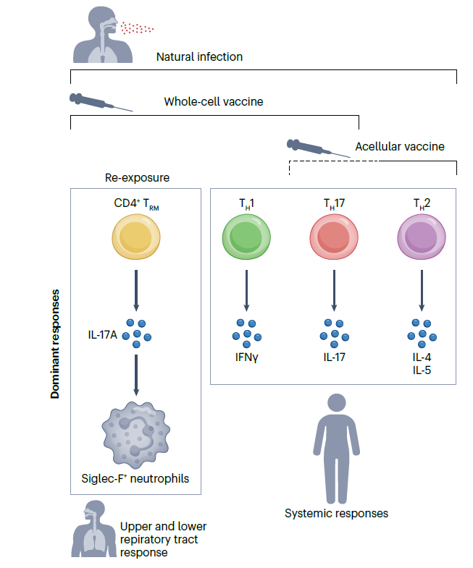
B. Pertussis infection, specific tissue-resident memory T (TRM) cells accumulate within the upper and lower respiratory tract, including the nasal cavity.
CD4+ TRM cells secret IL-17A, involved in the clearance of B. pertussis from the nasopharynx and, upon reinfection, promotes the recruitment of neutrophils (in particular Siglec-F+) to the nasal mucosa.
Immunization with a whole-cell vaccine results in:
Accumulation of CD69+CD4+ TRM cells within the upper respiratory tract following re-exposure to B. pertussis.
Significantly reduce the B. pertussis loads within the nasopharynx and prevent transmission to non-infected whereas an acellular vaccine fails to prevent transmission.
Differences protection is due to the absence of an increase in TH1 and TH17 lymphocyte activity in individuals receiving an acellular vaccine.
Nature Reviews Microbiology, 2024
Notes:
Nature Reviews Microbiology

Slide 44
5. Immunological Distinction between wP & aP Vaccine
 | T Cell Response | B Cell Response | Protection against Disease |  | Bacterial Clearance (Sterilizing protection) | Transmission
 |  |  | Short Term | Long Term
Whole-cell vaccine | Th1/Th17/TFH | Opsonizing & Neutralizing IgG Abs (Ig2a) | Yes | Protection up to 10 years | Rapid & high-level clearance of pathogen nasopharynx & lungs | Low Risk
Acellular vaccine | Th2 | Low levels of Opsonizing & Neutralizing IgG Abs (IgE, IgG1/IgG4) | Yes | Waning immunity at 3-5 years | Failure to clear B. pertussis from the nasopharynx | High Risk
Natural infection | Th1/Th17/TFH | Opsonizing & Neutralizing IgG Abs | Yes | Protection > 10 years | Rapid & very high level clearance of pathogen from respiratory tract | Very Low Risk
Immunization with aP vaccines is ineffective at generating protective immunity against nasal colonization with B. pertussis.

Slide 45
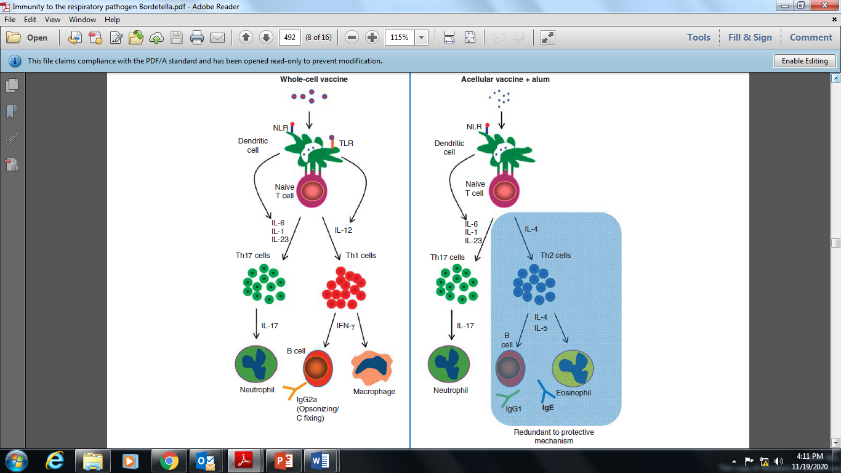
Distinct Mechanisms of Immunity-induced with Whole-cell and Acellular Vaccines
Whole-cell Vaccine
Acellular Vaccine
Long-term Protection
Short-term Protection
IgE
IgG2a
IgG1/IgG4
MucosalImmunology, 5 (5), 2012

Slide 46

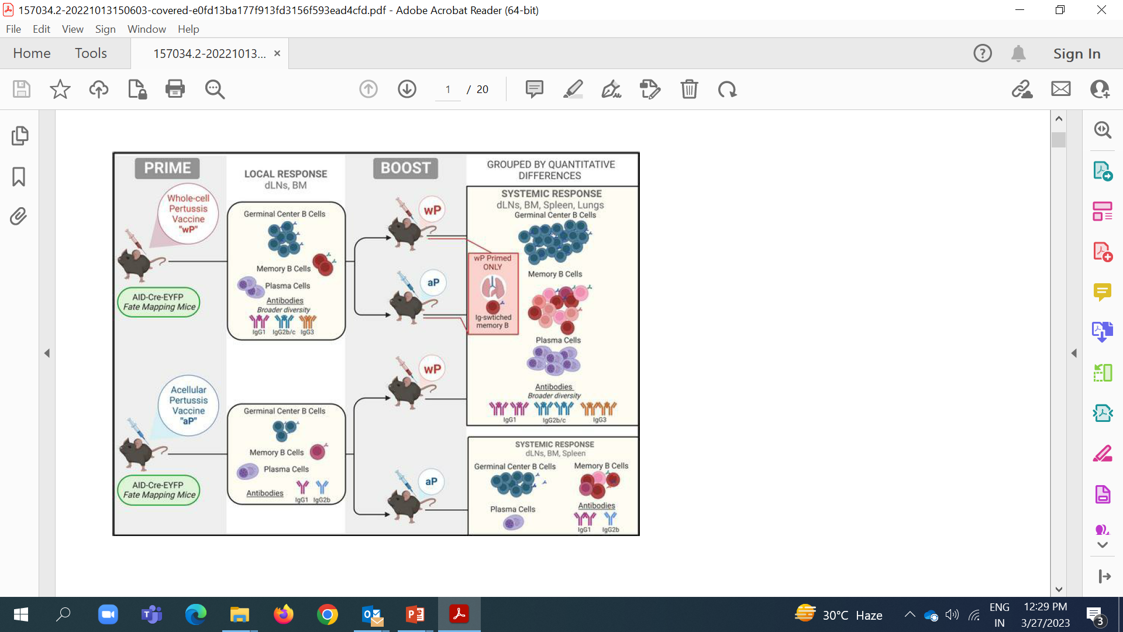
Whole-cell pertussis vaccine Imposes a Broad Effector B cell
Response in Heterologous prime-boost Settings
wP Priming & boosting with wP/aP
Increases expression of Germinal Cells (GC)
Increases memory B Cells
Increases number of Plasma Cells
wP:wP
wP:aP
LONG-TERM PROTECTION
wP boost post aP prime partially reverses response to wP-like profile
aP:wP
aP Priming & aP boosting
Decreased expression of Germinal Cells (GC)
Decreased memory B Cells
Decreased number of Plasma Cells
Decreased broader diversity of antibodies
aP:aP
Homologous or heterologous vaccine combinations with at least 1 wP administration, even as a booster dose, is sufficient to induce broad effector response, thus highlighting its dominant imprint on the B cell profile.
SHORT-TERM PROTECTION

Slide 47
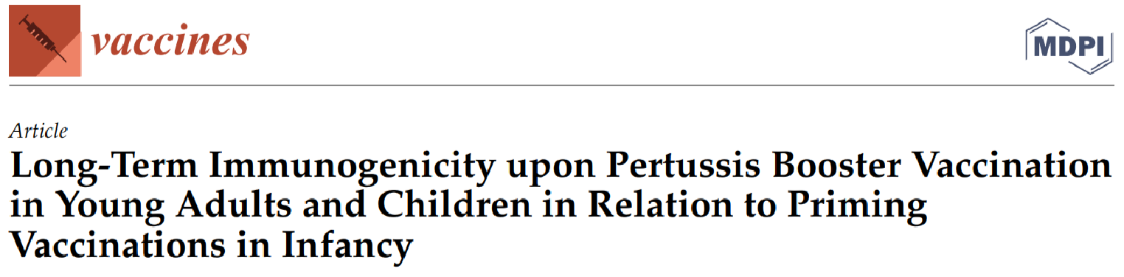
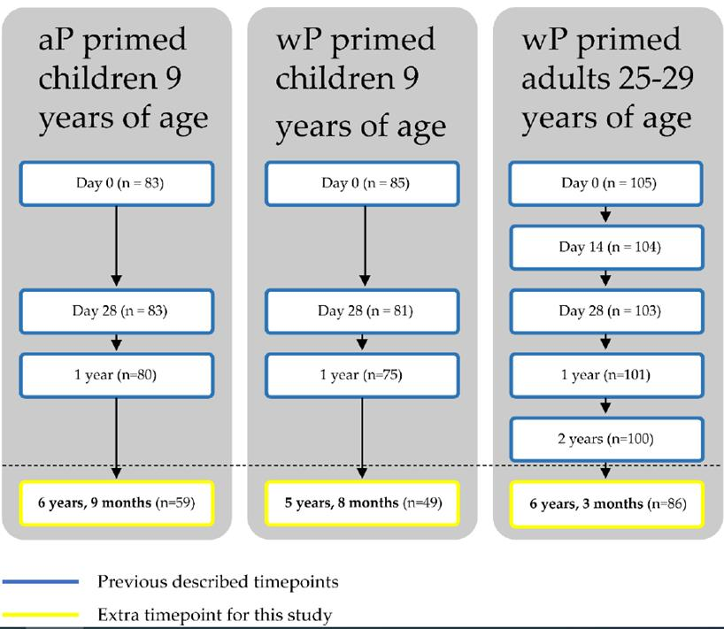
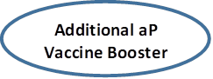
Study Objective: Phase IV longitudinal interventional study, to assess the long-term immunity (pertussis antibody concentrations) following an pertussis booster vaccination (aP vaccine) in aP and wP primed children (9 years of age) and wP primed adults (25-29 years of age).
Children (9 years of age) were primed in infancy with either the whole cell pertussis (wP) vaccine (n = 49) or acellular pertussis (aP) vaccines (n = 59), and all children received a preschool aP booster.
Adults (25–29 years, n = 86) were wP-primed in infancy and did not receive a preschool booster.
Additional aP booster was administered to both children (aP & wP primed) and adult (wP primed). All were followed-up for approximately 6 years.
Vaccines 2022

Slide 48
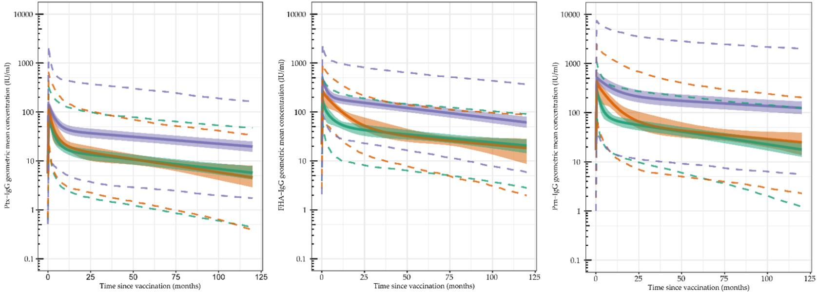
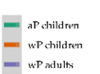
Antibody Kinetics
Figure A; Pertussis Toxin (Ptx) Figure B: Filamentous Hemagglutinin (FHA) Figure C: Pertactin (Prn)
Pertussis Toxin (Ptx): Ptx initial peak was higher in wP-primed children and adults compared with aP-primed children. Adults exhibited a slower decline and a higher upkeep of Ptx antibodies over time (Figure A)..
Filamentous Hemagglutinin (FHA): Highest peak in antibody concentrations was seen in wP-primed adults, followed by wP-primed children, and was lowest in aP-primed children (Figure B)..
Pertactin (Prn): Decline in Prn-specific antibody concentrations in wP-primed children was slower compared to aP-primed children with a longer duration.
Vaccines 2022

Slide 49
Antibody Concentrations & Pertussis Infection
Pertussis antibody titers: After the additional booster, antibody responses to pertussis were higher in adults (wP primed) compared with children (wP or aP primed), and antibody concentrations remained higher for at least a decade.
Pertussis Infection: Pertussis infection were more in aP-primed children (12%) compared with wP-primed individuals (2%) (p = 0.052).
Vaccines 2022

Slide 50
Conclusion
aP booster vaccination in aP-primed children offers less long-term protection against pertussis infection and against transmission.
aP priming in combination with aP boosting may not be sufficient to prevent circulation and transmission, while wP-primed adults may benefit from enhanced long-lasting immunity.
Vaccines 2022

Slide 51
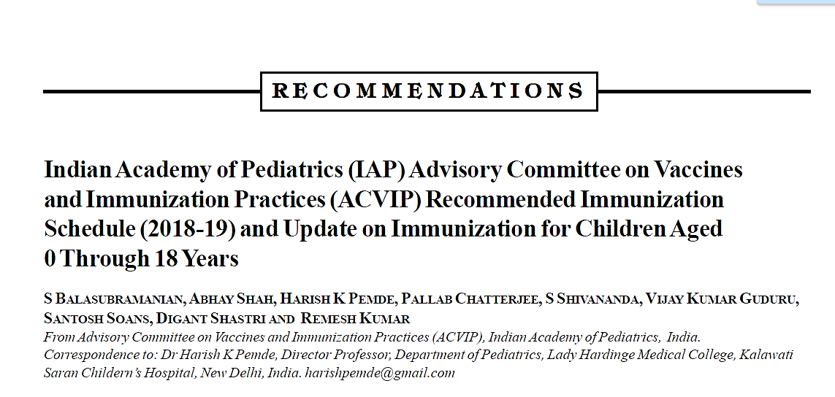
Indian Academy of Pediatrics Advisory Committee Recommendations
Long-term efficacy over 10 years has been observed to be superior with whole cell pertussis vaccine (wP).
Recent outbreaks of pertussis in various developed countries have sparked a debate on the effectiveness of acellular pertussis (aP) vaccines.
Though the reasons for this resurgence are complex and vary from place to place, the lesser duration of protection and decreased impact on transmission of the disease by acellular pertussis vaccines appears to be crucial
Current evidence suggests that the efficacy of both aP and wP vaccines in preventing pertussis in the first year is equivalent.
After the first year, the immunity wanes more rapidly with the aP vaccines and the impact on transmission by aP vaccines is also inferior to wP vaccines.
WHO clearly mentions that countries currently using the wP vaccine in their national programs should continue the same for the primary series, while those using the aP vaccine should continue the same and consider additional boosters and strategies.
wP vaccine is definitely superior to aP vaccine in terms of immunogenicity and duration of protection, but more reactogenic.
Balasubramanian S, et al. Indian Pediatr. 2018;55(12):1066–1074.
aP: Acellular pertussis; wP: Whole-cell pertussis; WHO: World Health Organization.
Notes:
This slide highlights the crucial recommendations given by Indian Academy of pediatrics on vaccine and immunization practice:
Long-term efficacy over 10 years has been observed to be superior with whole-cell pertussis vaccine (wP).
Recent outbreaks of pertussis in various developed countries have sparked a debate on the effectiveness of acellular pertussis (aP) vaccines.
Though the reasons for this resurgence are complex and vary from place to place, the lesser duration of protection and decreased impact on transmission of the disease by acellular pertussis vaccines appears to be crucial.
Current evidence suggests that the efficacy of both aP and wP vaccines in preventing pertussis in the first year is equivalent.
After the first year, the immunity wanes more rapidly with the aP vaccines and the impact on transmission by aP vaccines is also inferior to wP vaccines.
World Health Organization clearly mentions that countries currently using the wP vaccine in their national programs should continue the same for the primary series, while those using the aP vaccine should continue the same and consider additional boosters and strategies.
Whole-cell pertussis vaccine is definitely superior to aP vaccine in terms of immunogenicity and duration of protection, but more reactogenic.
Reference
Balasubramanian S, Shah A, Pemde H, et al. Indian Academy of Pediatrics (IAP) Advisory Committee on Vaccines and Immunization Practices (ACVIP) Recommended Immunization Schedule (2018-19) and Update on Immunization for Children Aged 0 Through 18 Years. Indian Pediatr. 2018;55(12):1066–1074.

Slide 52
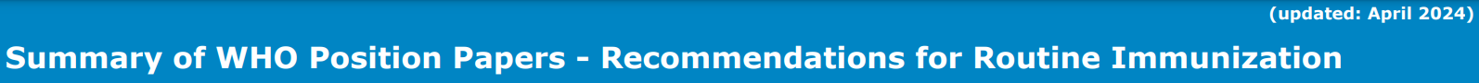
Summary of WHO Position Papers
Pertussis vaccine: Both aP-containing and wP-containing vaccines have excellent safety records.
Available evidence indicates that licensed aP and wP vaccines have equivalent initial effectiveness in preventing disease in the first year of life, but that there is more rapid waning of immunity, and possibly a reduced impact on transmission, with aP relative to wP vaccines.
National programmes currently administering wP vaccination should continue to use wP vaccines for primary vaccination series. Surveillance and modelling data suggest that the use of aP vaccines may result in a resurgence of pertussis after a number of years.
National programmes currently using aP vaccine may continue using this vaccine but should consider the need for additional booster doses and strategies to prevent early childhood mortality such as maternal immunization in case of resurgence of pertussis.
Recommendations for Routine Immunization (updated: April 2024) P.5 / 12

Slide 53

THANK YOU

